Slide 1
Oracle Database 12c Detective Controls
Detective Controls

Slide 2
Introduction
Course Description
Hands-on intermediate course where participants learn how they can use Oracle Database administration auditing features to meet compliance requirements. Participants learn how to audit the access to their databases and how to use the auditing and compliance features to monitor data access and confidentiality.
Participants learn about Oracle solutions for common problems
Skillset
Security Intermediate Skillset

Slide 3
Introduction
We will cover the following:
Implement Oracle Audit Vault
Implement Database Firewall
Oracle Virtual Private Database (VPD)
Data Redaction
Oracle Privilege Analysis
Enumerate Oracle Database Auditing Solutions
Oracle Database Vault
Database Vault and Data Pump
Oracle Application Context
Explain Oracle Compliance Framework
Configure Compliance Framework rules

Slide 4
Oracle Database 12c Detective Controls
Oracle Audit Vault

Slide 5
Oracle Audit Vault
What is Audit Vault and Firewall?
Continuous auditing of Oracle and and non-Oracle databases
Audits:
File system
Application
Audit specific data

Slide 6
Oracle Audit Vault
What is Audit Vault and Firewall?
Firewall
First line of network defense
Prevents SQL injection
Application bypass
Enforces expected behaviour

Slide 7
Oracle Audit Vault
Consolidates audit data from thousands of databases as well as monitors SQL traffic
Prevents un authorized SQL statements or out of policy statements
Supports most major Databases
DB2
SQL Server
MySQL

Slide 8
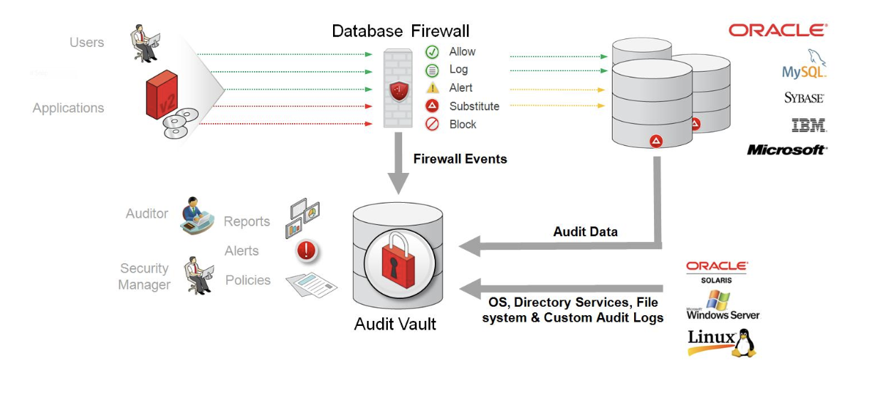
Oracle Audit Vault

Slide 9
Oracle Audit Vault
Consolidates audit data from thousands of databases as well as monitors SQL traffic
Prevents un authorized SQL statements or out of policy statements
Supports most major Databases
DB2
SQL Server
MySQL

Slide 10
Oracle Audit Vault
Why Audit Vault and Firewall?
Today’s world everything is audited
Audit only tracks attempts
Most organizations are not just Oracle

Slide 11
Oracle Audit Vault
Why Audit Vault and Firewall?
Oracle Audit Vault and Firewall consolidates all auditing to one centralized location
Reports may be established
Alerts can be established
Real time alerts and monitoring

Slide 12
Oracle Audit Vault
Why Audit Vault and Firewall?
Oracle Audit Vault and Firewall consolidates all auditing to one centralized location
Reports may be established
Alerts can be established
Real time alerts and monitoring

Slide 13
Oracle Audit Vault
Difference between Audit Vault and Firewall
Firewall determines if an event may go through the firewall
Audit tracks the event
Firewall is proactive
Firewall has 3 states
Permit
Block
Modify

Slide 14
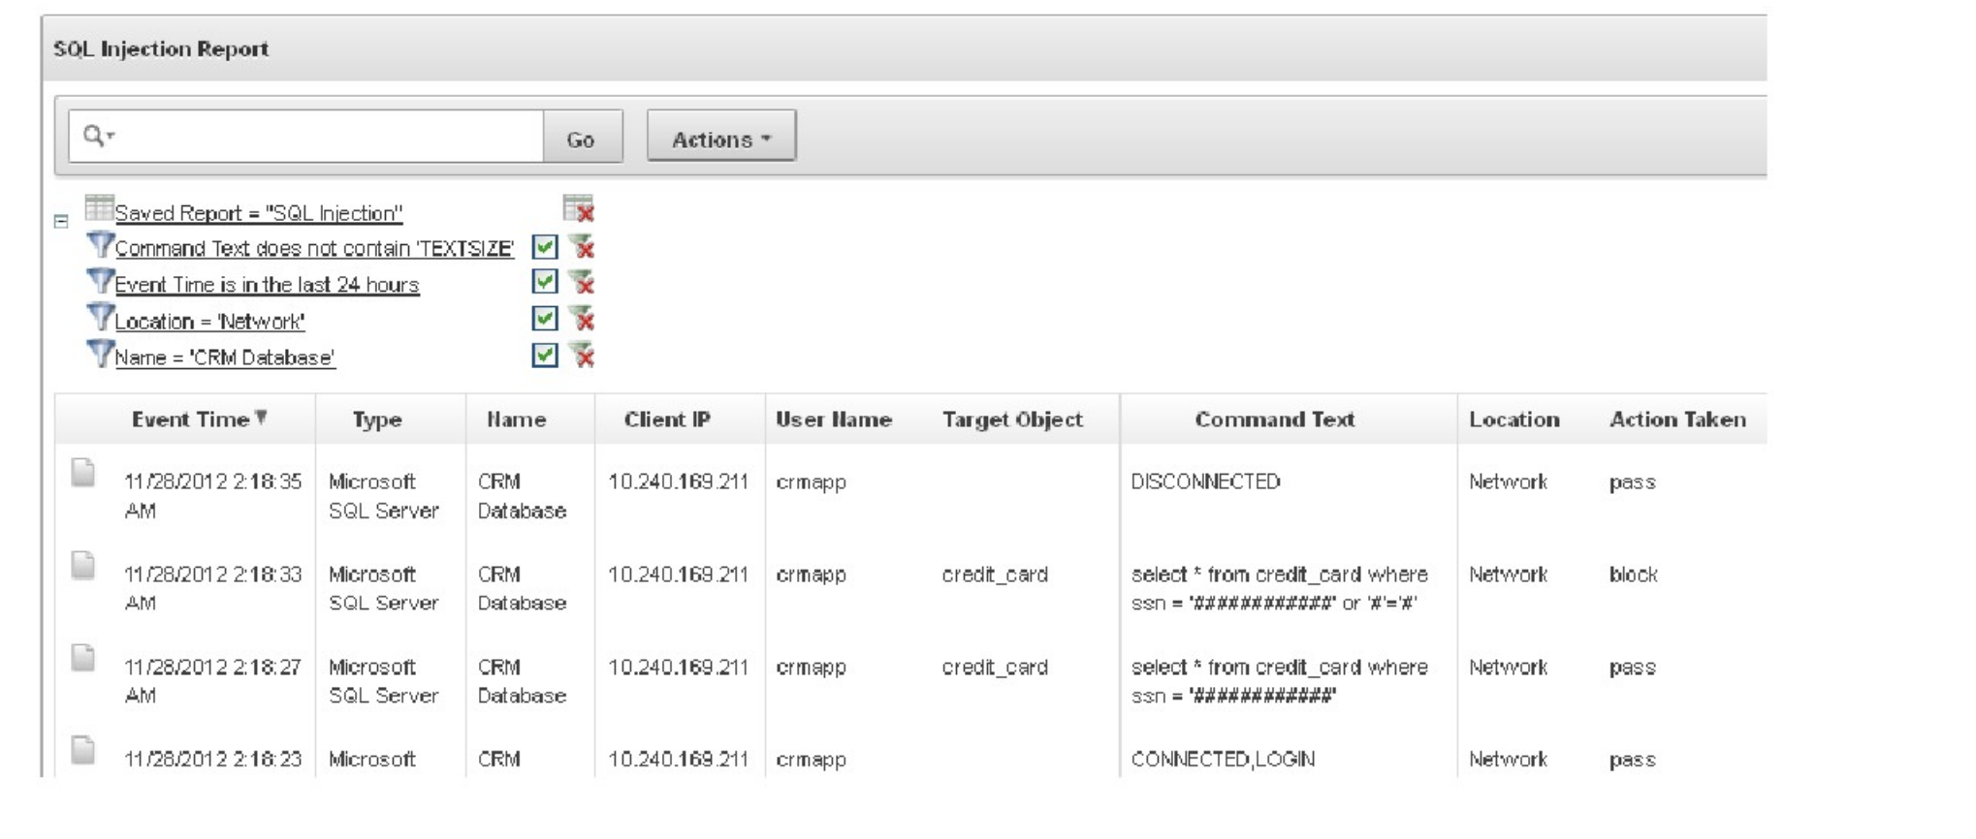
Oracle Audit Vault
Firewall identifies and attempt and blocks

Slide 15
Oracle Audit Vault
Audit Vault
Database repository that stores consolidated audit information
Enabled via lightweight agents
Audit information from many different:
Databases
File systems
Applications
Single source of audit data

Slide 16
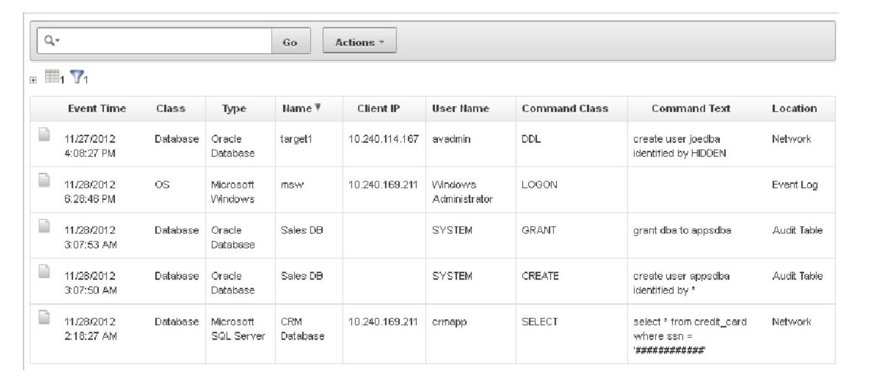
Oracle Audit Vault

Slide 17
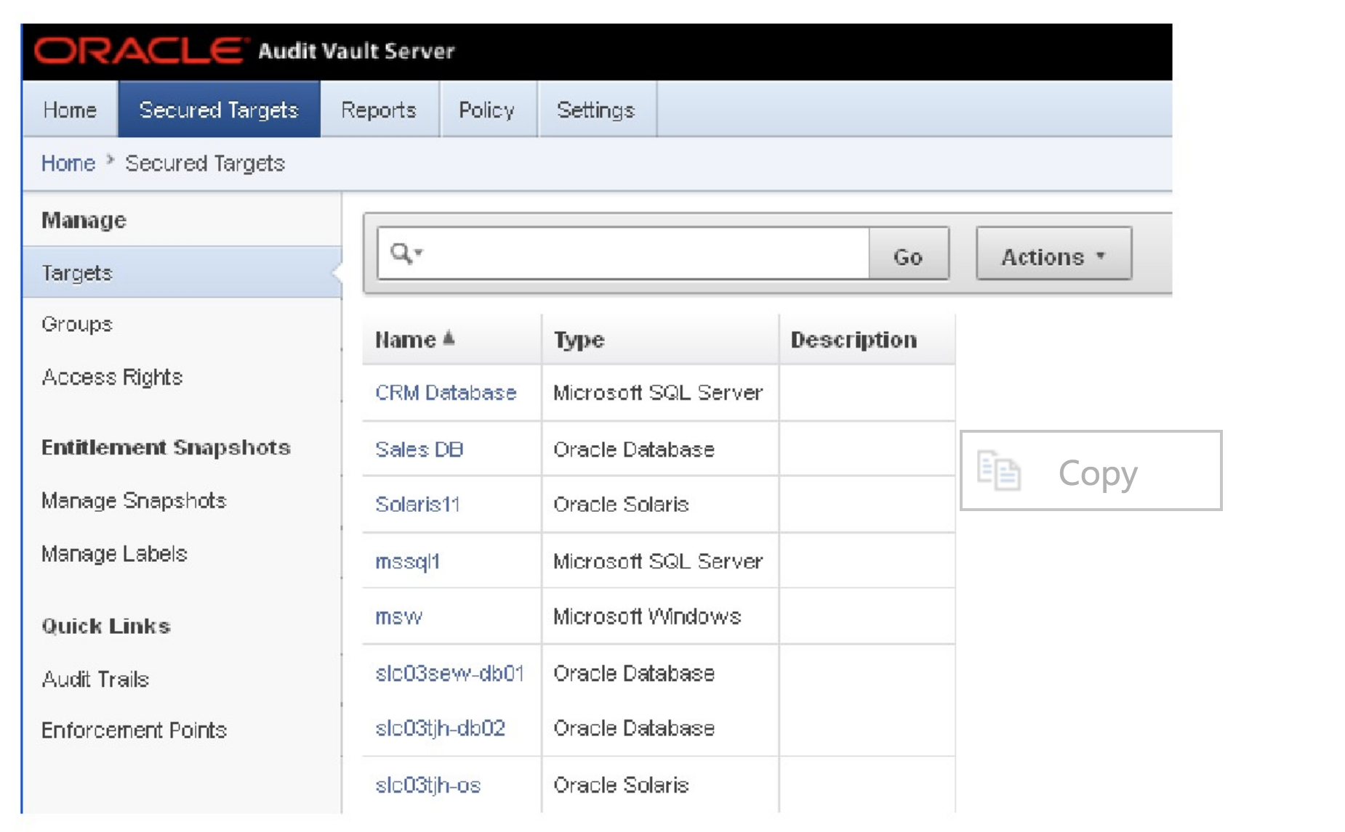
Oracle Audit Vault
How is Audit Vault implemented
Audit Vault Server
Audit Vault agents
Similar to OEM

Slide 18
Oracle Database 12c Detective Controls
Oracle Database Firewall

Slide 19
Database Firewall
Specifically what is Oracle’s Database Firewall?
A network monitoring component outside the database that monitors the inbound SQL traffic and serves as a first line of defense against SQL injection threats and other unauthorized SQL statements
Monitors data access, enforces access policies, highlights anomalies and helps protect against network based attacks originating from outside or inside the organization

Slide 20
Database Firewall
What does Database Firewall do?
Deploy Database Firewall in active monitoring mode to protect a database assets or in passive monitoring mode to alert security operations personnel of unexpected activity, and/or supplemental auditing to address compliance requirements
Passive monitoring mode, Database Firewall observes database traffic and analyzing SQL interactions

Slide 21
Database Firewall
What does Database Firewall do?
Data from Database Firewall is logged to the Audit Vault, providing reports to span information observed on the network alongside audit information from the database, operating systems, and directories
In active monitoring mode, Database Firewall transparently intercepts SQL traffic coming from database clients acting as an application layer firewall, analyzes the security of the SQL payload in TCP packets before forwarding it on to the database

Slide 22
Database Firewall
How does Database Firewall work?
White List Policy
Enforces security using a set of approved SQL statements along with the conditions under which they were executed including the username, IP address, time of day, and program name
Compares SQL traffic with the approved white list and then based upon the policy, it chooses to alert, substitute, or block the SQL statement

Slide 23
Database Firewall
White List Policy
The approved SQL or white list is learned over time by monitoring database traffic
The period of time varies depending upon organization

Slide 24
Database Firewall
Black List Policy Enforcement
A black list model that blocks specific SQL statements
Evaluate various factors such as username, IP address, time of day and program, before making the decision
Exception List Policy Enforcement
Exception lists policies override white list and black list policies by allowing custom bypass policies to be created for specific activities
Exception list policies could be used to enable a specific remote administrator coming from a predetermined IP address to diagnose a particular application performance issue without being bound by the white list or the blacklist

Slide 25
Database Firewall
Unauthorized SQL is handled in different ways
Terminates the connection/blocks all incoming traffic from that connection
Blocks the SQL statement
Modifies the request
Alerts on out of policy SQL Statement

Slide 26
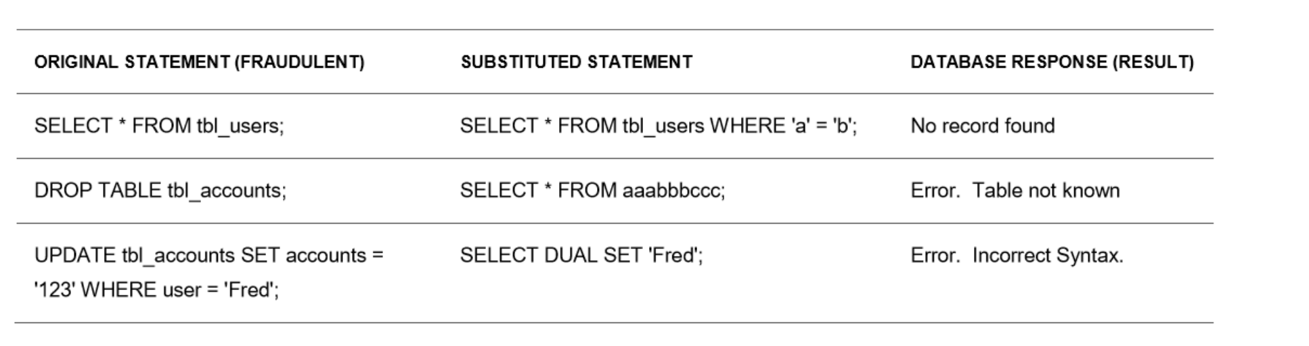
Database Firewall

Slide 27
Database Firewall
Additional Audit Reporting
Audit Vault and Database Firewall have predefined reports
Reports can display consolidated audit information from databases, operating systems, and directories, providing a holistic picture of activities across the enterprise
Reports can include information on database account management, roles and privileges, object management, and stored procedure changes

Slide 28
Database Firewall
Additional Audit Reporting
Reports can be interactive, through an Auditor Console web interface, or PDF or XLS report files
PDF and XLS report definitions can be used to schedule automatic report generation

Slide 29
Database Firewall
Compliance Reporting
Payment Card Industry Data Security Standard (PCI-DSS)
Gramm-Leach-Bliley Act (GLBA)
Health Insurance Portability and Accountability Act (HIPAA),
Sarbanes-Oxley Act (SOX)
European Union Data Protection Act (DPA)

Slide 30
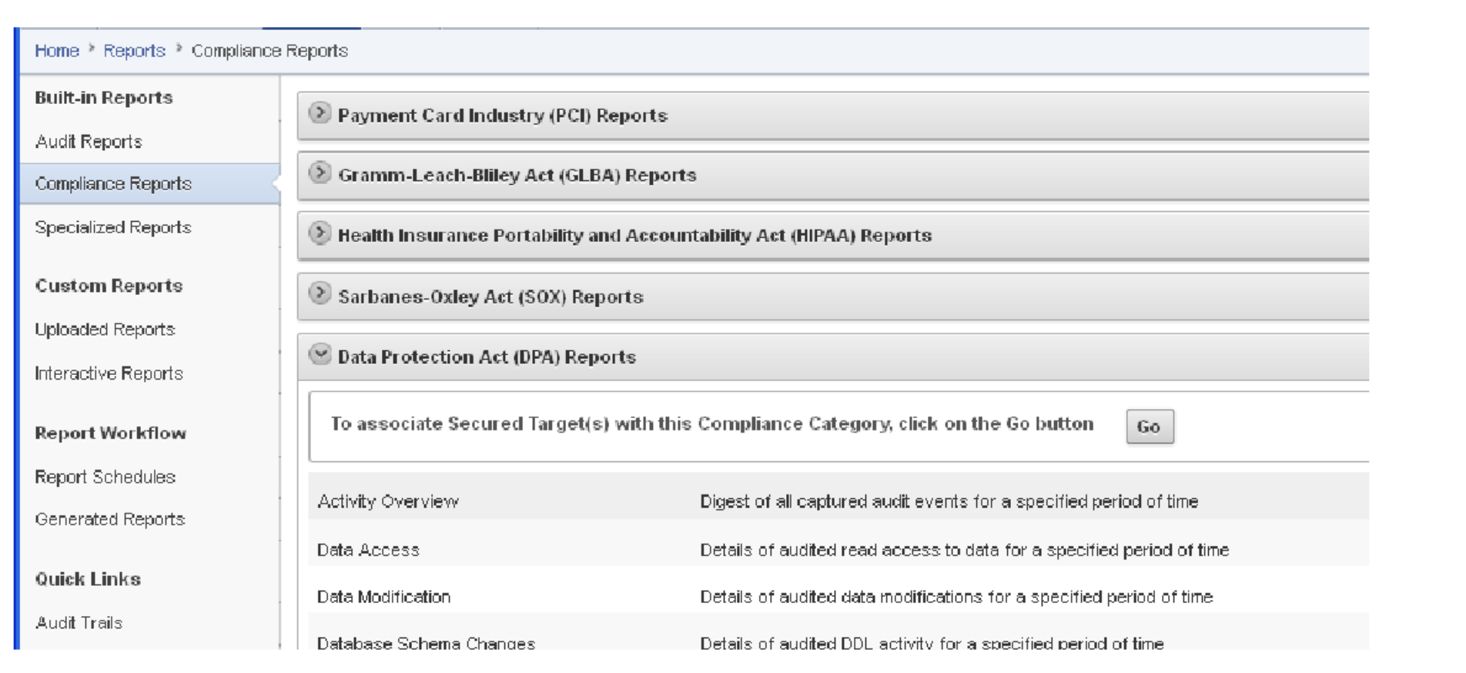
Database Firewall

Slide 31
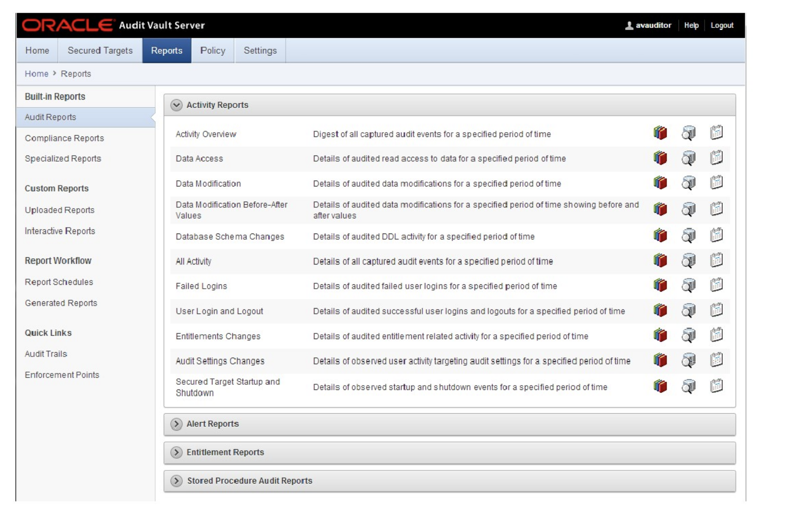
Database Firewall

Slide 32
Database Firewall
Entitlements Reporting
Describe the types of access that users have to an Oracle database
Information about the users, roles, profiles, and privileges used
Compare different snapshots to find how the entitlement information has changed over time
Stored Procedure Audit Reports
Monitor any changes made to the Stored Procedures on the protected databases
Shows all stored procedure operations, deleted and created procedures, as well as modification history

Slide 33
Database Firewall
Alerts and Notifications
Detect and alert on activities that may indicate attempts to gain unauthorized access and/or abuse system privileges
Generate alerts on network activity
Alerts can be associated with any database event including system events such as changes to application tables, creating privileged users
Events when someone attempts to access sensitive business information and is blocked by an Oracle Database Vault policy

Slide 34
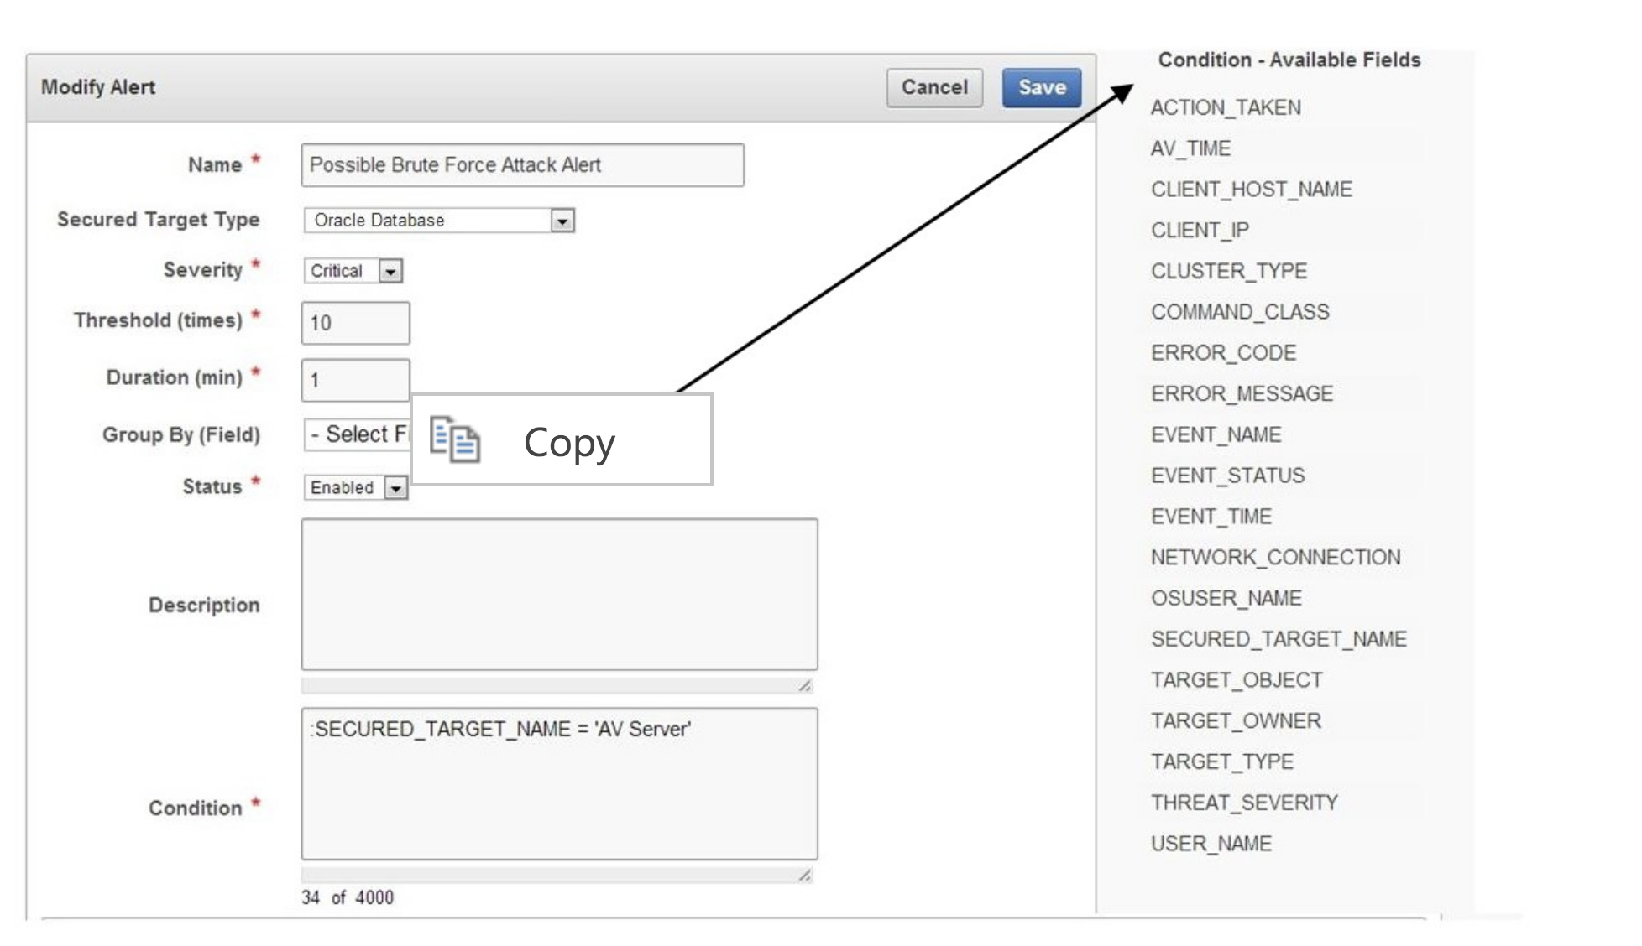
Database Firewall

Slide 35
Database Firewall
Deployment
Deployed as a transparent network bridge, simply inserted into the network in a segment that lies between database clients/application servers and the databases being protected
Supports a local server-side, monitor-only agent to ensure flexibility in the choice of the network point at which the traffic is monitored

Slide 36
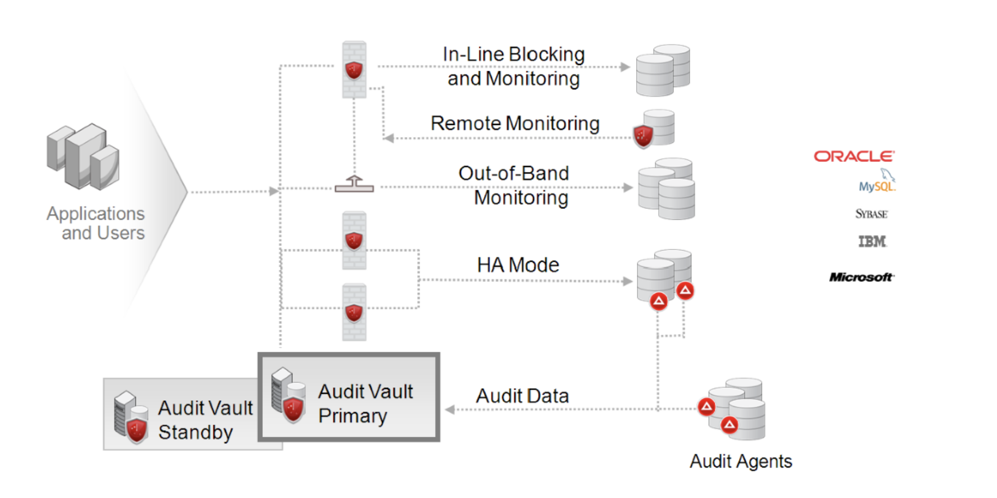
Database Firewall

Slide 37
Database Firewall
Audit Agents Deployment
Distributed as JAR files to the target systems and require no additional manual configuration or updates once they have been distributed
Policy Authoring and Management
Define a white list, black list, or exception list of SQL statements for a given database

Slide 38
Oracle Database 12c Detective Controls
Virtual Private Database

Slide 39
Introduction
In this chapter, we will cover the following:
Creating different policy functions
Creating Oracle Virtual Private Database row-level policies
Creating column-level policies
Creating a driving context
Creating policy groups
Setting context as a driving context
Adding a policy to a group
Exempting users from VPD policies

Slide 40
Introduction
Oracle Virtual Private Database (VPD) is a security feature, introduced in Oracle Database 8i.
Discretionary access control (DAC) grants/restricts access to data at an object level.
VPD enables you more granular control over security of your data.
Notes:
It is available only in Enterprise Edition of Oracle Database.
This means that a user can access either the entire data in a table or no data.
Using VPD, you can restrict access to data at row level or column level.
VPD doesn't replace DAC, but it is complimentary to DAC. VPD can further restrict access to users who have been given access to data by DAC.

Slide 41
Introduction
There are five types of policies based on how often a policy function is evaluated:
DBMS_RLS.DYNAMIC
DMBS_RLS.STATIC
DBMS_RLS.SHARED_STATIC
DBMS_RLS.CONTEXT_SENSITIVE
DBMS_RLS.SHARED_CONTEXT_SENSITIVE
Notes:
DBMS_RLS.DYNAMIC is default.

Slide 42
Introduction
Steps to implement the VPD policy
Create a PL/SQL package that sets application context
Create an application context
Create a policy function
Create a VPD policy
Notes:
Although it is not necessary to use application contexts when implementing VPD policies, it is a common practice. Figure 1 shows usual steps that you will need to complete to implement the VPD policy on protected objects, such as table or view:

Slide 43
Introduction
A driving context is an application context that has at least one attribute and its purpose is to determine which group of policies will be applied.
Notes:
The driving context is set by an application that is trying to access the data.

Slide 44
Introduction
Steps to implement policy groups
Determine the default policies
Create and set the driving context
Create a policy group for each application
Add policies to the appropiate policy groups
Notes:
The default VPD behavior is that all policies defined on a table or a view are enforced for all SQL statements regardless of the application that executes them. If multiple applications share a table or a view, it is highly likely that you will either need to establish more complex logic to handle security requirements (to determine in which case, which predicate should be returned) or change the default VPD behavior by creating and using policy groups. If policies are already defined, you should identify which policies should be in effect when each application accesses the table or view. Each object has a predefined default policy group (SYS_DEFAULT), and the policies defined in this group are always applied for that particular object. A driving context determines which other policy group will also be applied at that time.
Suppose that there are two applications (A and B) that access data in table HR.EMP_VPD_TEST. Their specific policies are defined in two policy groups (HR_GRP_A and HR_GRP_B), and policies that should be enforced in any case are defined in the default group (SYS_DEFAULT). When application A accesses the data, policies that belong to HR_GRP_A and SYS_DEFAULT groups are applied, and when application B accesses the data, polices that belong to HR_GRP_B and SYS_DEFAULT groups are applied (it is assumed that the driving context is properly set).

Slide 45
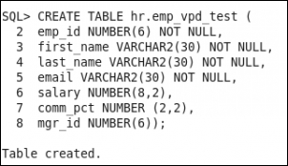
Creating different policy functions
The purpose of a policy function is to return a predicate that will be applied in WHERE clause of the statement (except for INSERT operation).
You'll create several simple policy functions, based on different business and security requirements.
You'll need to create the table hr.emp_vpd_test, insert several values into that table, and create several user.

Slide 46
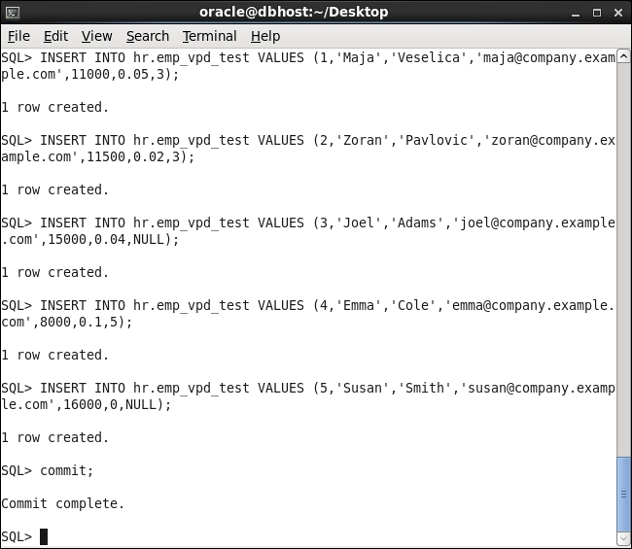
Creating different policy functions
Test data in the table hr.emp_vpd_test

Slide 47
Creating different policy functions
Create a policy function that uses the application context you created, where as other policy functions you created use built-in application contexts.
A policy function can be part of a package or is standalone.

Slide 48
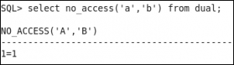
Creating different policy functions
To test whether a policy function where a user can't access data in a table and other users can access entire data in the table:
Connect to the database as the user maja and execute the following statement:
Notes:
Maja can access data

Slide 49
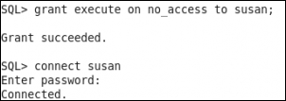
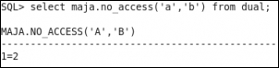
Creating different policy functions
Grant the user susan execute on no_access function and connect to the database as the user susan.
Execute the following statement:
select maja.no_access('a','b') from dual;
Notes:
2. Temporary grant the susan privilege
3. Susan can't access data

Slide 50
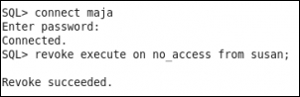
Creating different policy functions
Connect to the database as the user maja and revoke execute on no_access function from the user susan.
Notes:
Clean up environment (revoke privilege)

Slide 51
Creating Oracle Virtual Private Database row-level policies
Oracle VPD row-level policies restrict users' access per row for a protected object.
This means that two users who execute the same query against, for example, a table may, as a result, receive different number of rows.

Slide 52
Creating Oracle Virtual Private Database row-level policies
You define two VPD policies on the same table, and they are both enabled.
The first one only restricts the user susan from accessing the table, whereas the other one affects all users connected to the database.
If susan connects to the database, both policies will determine whether she can access the data and if yes, which data.
The way the policies are defined, she won't be able to view data in the table.

Slide 53
Creating column-level policies
When you create a column-level VPD policy, you define sensitive columns, and if those columns are referenced in a query, statement will be rewritten.
To create a column-level VPD policy, you also use the DBMS_RLS.ADD_POLICY procedure.

Slide 54
Creating column-level policies
Create the test_col VPD policy.
The user is granted the role (HREMP_TEST) that will allow him to view entire data.
Restrict displayed rows by TEST_POL2, so user can view only his data.

Slide 55
Creating column-level policies
Disable the TEST_POL2 policy using the DBMS_RLS.ENABLE_POLICY procedure. The syntax is:
Other user can view all rows, but cannot view salary and comm_pct, because he doesn't have the HREMP_TEST role.
DBMS_RLS.ENABLE_POLICY (
object_schema IN VARCHAR2 NULL,
object_name IN VARCHAR2,
policy_name IN VARCHAR2,
enable IN BOOLEAN TRUE)
Notes:
4. to disable the policy, you set enable parameter to false

Slide 56
Creating a driving context
Having multiple VPD policies is harder to manage, and it can lead to unexpected/unwanted results.
For example, you have two applications and want to create two policy groups.
If the first application accesses the table, the test_pol1 and test_col policies should be enforced, and if second application accesses the table, the test_pol2 policies should be applied.
Notes:
3. There will be no default policies.

Slide 57
Creating a driving context
You'll create an application context and set it.
You'll need an existing user who can create an application context.

Slide 58
Creating policy groups
You'll create two policy groups that will be applied to table hr.emp_vpd_test.
You'll need an existing user who has appropriate privileges.

Slide 59
Setting context as a driving context
You'll make an existing application context a driving context (you'll associate it with the protected object).
You'll need an existing application context and an existing user who has appropriate privileges.

Slide 60
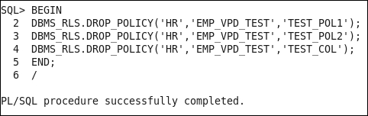
Adding policy to a group
Create VPD policies as part of a policy group.
You'll need an existing user who has appropriate privileges. Drop all VPD policies using the DBMS_RLS.DROP_POLICY procedure.
Drop policies

Slide 61
Exempting users from VPD policies
VPD policies are not enforced for users who connect as sysdba, during direct path export, and for users who have the EXEMPT ACCESS POLICY privilege.
You'll connect to the database as SYS user and grant EXEMPT ACCESS POLICY to an existing user.

Slide 62
Oracle Database 12c Detective Controls
Data Redaction

Slide 63
Introduction
We will cover the following:
Creating a redaction policy when using full redaction
Creating a redaction policy when using partial redaction
Creating a redaction policy when using random redaction
Creating a redaction policy when using regular expression redaction
Using Oracle Enterprise Manager Cloud Control 12c to manage redaction policies
Changing the function parameters for a specified column
Adding a column to the redaction policy
Enabling, disabling, and dropping a redaction policy
Exempting users from data redaction policies

Slide 64
Introduction
Oracle Data Redaction is a new security feature, introduced in Oracle Database 12c.
Oracle Data Redaction masks sensitive data just before the results of the SQL query are returned to the application that issued the query.
Data stored in the database is NOT changed in any way.
Notes:
From a licensing viewpoint, it is part of the Advanced Security Option (only available as an option for Oracle Database Enterprise Edition). However, afterwards, Oracle decided to make it available in Oracle Database 11g as well (only in version 11.2.0.4).
The main idea behind this feature is to mask (hide/redact) some (sensitive) data from end-users. Having this in mind, it is logical that you will primarily use this security solution in a production environment.

Slide 65
Introduction
Oracle Data Redaction and Oracle Data Masking are both used to mask sensitive data, but these solutions are completely different.
Oracle Data Masking enables organizations to use production data in development and test environments by changing production data with realistic data (transformation is done by using masking rules).
Notes:
—from the way they are designed (how they work) to their target implementation use cases

Slide 66
Introduction
When you implement Oracle Data Redaction, you have to decide the following:
What data should be redacted
Which redaction method is most suitable for the identified data
In which situations the redaction should take place

Slide 67
The parts of a redaction policy
WHAT | Schema, object, column
HOW | Redaction type, required parameters
WHEN | SQL expression

Slide 68
The types of redaction
None | Full | Partial | Regular Expression | Random
Redaction is NOT applied | Columns are redacted to constant values depending on column data type | User-specified positions are replaced by a user-specified characther | Pattern for matching and replacing is defined and used for redaction | Preserves data types Randomizes output
Notes:
You can define only one redaction policy on a table (or view).

Slide 69
Introduction
To view which data redaction policies are defined and whether they are enabled, you can query the redaction_policies view.
Also, it is very useful to query the redaction_columns view, which shows which columns will be masked and what type of redaction will be used.
We assume that database is up and running, and each user has at least a create session privilege.
Notes:
Note that the names of those two views do not have any prefix (such as DBA_, USER_, or ALL_).
Although Oracle Data Redaction as a concept is fantastic, you should keep in mind that there are some implementation limitations (for example, unsupported data types) and unexpected behavior (most likely bugs) observed in Oracle Database 12.1.0.2.
Recipes are tested on Oracle Database 12.1.0.2.

Slide 70
Creating a redaction policy when using full redaction
You will create a redaction policy on the income_level column, find the default values for different data types, and change the default value for the varchar2 data type.
Notes:
income_level column: on the income_level column on the CUSTOMERS table in the sample schema OE
Default values: (for full redaction)
You may consider data about customer address to be sensitive. Unfortunately, you can't create a redaction policy on the CUST_ADDRESS column (the table CUSTOMERS in the sample schema OE) because its data type is not supported (its data type is TYPE, which is not a literal value, so it can't be redacted). If you try to create a redaction policy, you will receive the following error: ORA-28073. The column CUST_ADDRESS has an unsupported data type.

Slide 71
Creating a redaction policy when using full redaction
You'll need the following:
An existing user who can view data in OE.CUSTOMERS sample table but doesn't have exempt redaction policy privilege (for example, oe)
To connect as a SYS user to the database
To restart the database

Slide 72
Creating a redaction policy when using full redaction
In order to manage redaction policies, you need to connect to a database as a user who has an execute privilege on the dbms_redact package.
Define redaction policy CUST_POL.
Creating a new redaction policy is done by using the ADD_POLICY procedure in the DBMS_REDACT package.
Notes:
3. A policy consists of several distinct sections

Slide 73
Creating a redaction policy when using full redaction
The WHAT section defines on which the column redaction policy should be applied.
The HOW section defines the redaction type.
The WHEN section defines the conditions when protected data will be masked.
Notes:
When: in situations when the expression is evaluated to TRUE, the data is masked

Slide 74

Creating a redaction policy when using full redaction
EMPLOYEES
NAME | SALARY
frank | 8800
emily | 9600
grace | 11300
SQL> SELECT * FROM EMPLOYEES;
DBMS_REDACT.ADD_POLICY
(object_schema => ‘GLDB’
object_name => ‘EMPLOYEES’
policy_name => ‘SAL_POLICY’
column_name => ‘SALARY’
function_type => DBMS_REDACT.FULL,
expression => ’7=7’);
NAME | SALARY
frank | 0
emily | 0
grace | 0
Notes:
Figure 5 - An example of the redaction policy applied on the column whose data type is a number
Figure 5 shows the example of creating a redaction policy (SAL_POLICY) using a full redaction method on a column (SALARY in table EMPLOYEES in schema GLDB) whose data type is a number. As you can see, the masked value is 0.

Slide 75
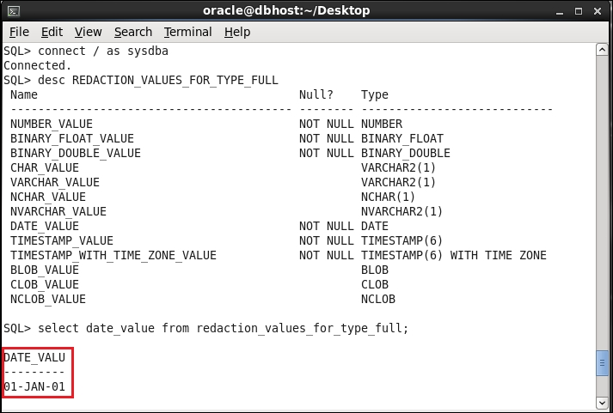
Creating a redaction policy when using full redaction
1
To find out default values for other data types, query REDACTION_VALUES_FOR_TYPE_FULL. Finding the default value for DATE data type is depicted
Notes:
Figure 6 - The default value for full redaction
At the time when you define data redaction policy, you can specify redaction for only one column. If you want to redact more than one column in a table, you can later modify the policy

Slide 76
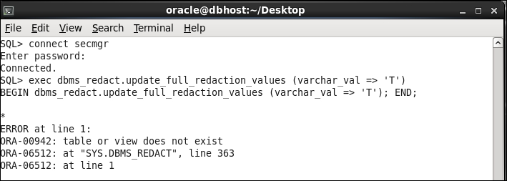
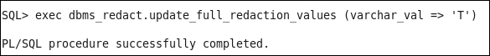
How to change the default value
1
An unsuccessful change of default value
Connect to the database as the SYS user and change the default value.
2
Notes:
You will use the update_full_redaction_values procedure to change the default value from whitespace to Tfor the varchar2 data type. Note that you can create a redaction policy, but you can't change the default value even though the user secmgr has been granted EXECUTE on the DBMS_REDACT package.
A successful change of the default value

Slide 77
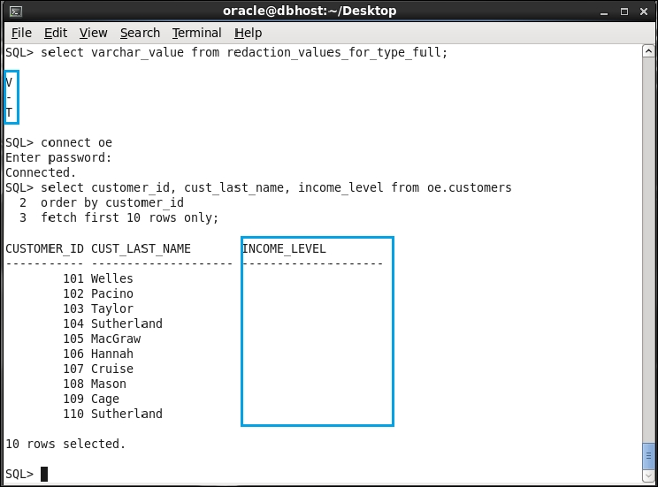
How to change the default value
3
Verify that the default value is changed and that there is no effect before you restart the database.

Slide 78
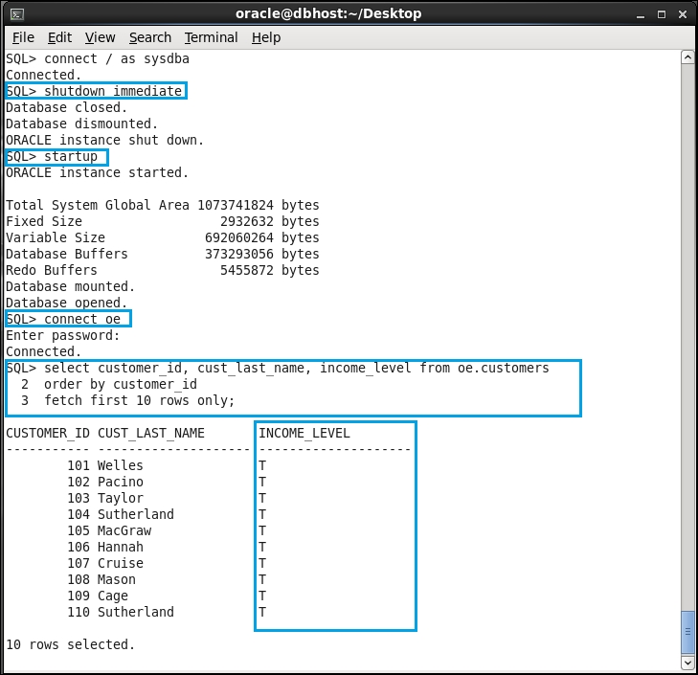
How to change the default value
4
Restart the database and verify that the modified default value is displayed.

Slide 79
Creating a redaction policy when using partial redaction
You will implement partial redaction on columns of two different types: Number and Varchar2.
Partial redaction means that only part of the data in a specified column will be masked whereas the other part of the data will be visible to the user.
Notes:
- for instance, the first 12 digits of credit card number will be redacted, whereas other 4 digits will be visible.

Slide 80
Creating a redaction policy when using partial redaction
In order to manage redaction policies and also to create some test tables, you can connect to a database as a user who has a dba role.
If you just need to manage redaction policies, you can connect with user who has the execute privilege on the dbms_redact package.

Slide 81
Creating a redaction policy when using partial redaction
Creation of redaction policy for number type column:
Create a redaction policy named a_tbl_partial.
Creating a new redaction policy is done by using the ADD_POLICY procedure in the DBMS_REDACT package.
A policy consists of several distinct sections, which column our redaction policy should be applied, redaction type, function parameters, condition when protected data will be masked.
Evaluate using the following expression: SYS_CONTEXT(''SYS_SESSION_ROLES'',''MYROLE'') = ''FALSE''
Notes:
Function parameters: in our case, it Is defined that first four digits will be redacted to 0
4. In this case, expression is true only if user doesn't have role myrole, and in this case, data in column a will be redacted (which is a case with the user usr2, whereas the user usr1, who has the role myrole, can see the unmasked data).

Slide 82
Creating a redaction policy when using partial redaction
Creation of redaction policy for the Varchar2 column type.
The difference is on function parameters and on condition, which is always TRUE.

Slide 83
Creating a redaction policy when using partial redaction
CUSTOMERS
NAME | CREDIT_CARD
tom | 3455647456589132
steve | 3734982321225691
john | 3472586894975806
SQL> SELECT * FROM CUSTOMERS;
DBMS_REDACT.ADD_POLICY
(object_schema => ‘ERNESTO’
object_name => ‘CUSTOMERS’
policy_name => ‘CCN_POLICY’
column_name => ‘CREDIT_CARD’
function_type => DBMS_REDACT.PARTIAL,
function_parameters => ‘VVVVVVVVVVVVVVVV,
VVVVVVVVVVVVVVVV, #,1,12’
expression => ’1=1’);
NAME | CREDIT_CARD
tom | ############9132
steve | ############5691
john | ############5806
Notes:
Partial redaction

Slide 84
Creating a redaction policy when using partial redaction
Even though users can't see unmasked data, they can use redacted columns in where clause:
SQL> select * from ernesto.customers;
NAME CREDIT_CARD
-------------------- ------------------------------
tom ############9132
steve ############5691
john ############5806
SQL> select * from ernesto.customers where credit_card like
'34%';
NAME CREDIT_CARD
-------------------- ------------------------------
tom ############9132
john ############5806

Slide 85
Creating a redaction policy when using random redaction
Random redaction type is usually used for the number and date-time data types because for these data types, it is hard to make a distinction between the redacted (random) and real data.
You will create redaction policy EMP_POL using random redaction type on hr.employees table, column salary, by using SQL*Plus.
You will modify the EMP_POL redaction policy.

Slide 86
Creating a redaction policy when using random redaction
To complete this, you'll need:
An existing user who can view data in the HR.EMPLOYEES sample table but doesn't have an exempt redaction policy privilege (for example, hr)
The secmgr user created in the Creating a redaction policy using full redaction recipe or another user who can create redaction policies (has execute on the dbms_redact package)

Slide 87
Creating a redaction policy when using random redaction
Create the redaction policy EMP_POL by using the procedure ADD_POLICY in the DBMS_REDACT package.
Define that random redaction type will be used to redact data.
Policy expression, specifies the blacklist (which contains only user HR).
To define a whitelist change operator = to operator <> and define left and right operand according to your needs.
Notes:
3. This means only the hr user is not allowed to view data in the column salary.
4. (for example, list only users who are allowed to view data, range of only those IP addresses from which access is allowed, and so on)
When defining security policies, it is a good practice to create whitelists.

Slide 88
Creating a redaction policy when using random redaction
When the number data type is redacted using random redaction type, the redacted value will belong to the interval [0, |n|], where |n| is the absolute value of the original data.
The only exception to this rule is when original data is an integer between −1 and 9, and in that case, the redacted value will belong to the interval [0, 9].

Slide 89
Creating a redaction policy when using regular expression redaction
A regular expression redaction type enables you to create and implement flexible redaction rules.
You define patterns that will be used in order to match and replace data, as well as some other parameters of the search.
You will create the redaction policy SHORT_POL, which will be used to mask customers' phone numbers.

Slide 90
Creating a redaction policy when using regular expression redaction
You'll need:
An existing user who can view data in the SH.CUSTOMERS sample table but doesn't have an exempt redaction policy privilege (for example, sh)
The secmgr user you created in the Creating redaction policy using full redaction recipe or another user who can create redaction policies (has execute on dbms_redact package)

Slide 91
Creating a redaction policy when using regular expression redaction
When creating redaction policies that use regular expression redaction type, you can choose between redaction shortcuts and the creation of custom regular expressions.
Notes:
redaction shortcuts : they exist for commonly redacted data, such as e-mail address, social security number, and postal code

Slide 92
Using Oracle Enterprise Manager Cloud Control 12c to manage redaction policies
You will perform several tasks with Data Redaction policies using Oracle Enterprise Manager Cloud Control 12c, including creation, modification, and deletion.
You need Enterprise Manager Cloud Control 12c and HR sample schema in the database.

Slide 93
Changing the function parameters for a specified column
There are several ways in which you can change an existing redaction policy. You will:
Change the function parameters for a specified column (the a_tbl_partial policy)
Add a column (commission_pct in the hr.employees table) to the redaction policy EMP_POL

Slide 94
Changing the function parameters for a specified column
Also, it is possible to remove column from the redaction policy, alter the policy expression, and modify the type of redaction for a specified column.
You concluded that the a_tbl_partial redaction policy doesn't satisfy the requirements for your application anymore because it redacts first four digits with 0 and leading zeros are not displayed in the application.
You decide to alter the a_tbl_partial policy.
Notes:
3. You want all digits to be displayed and to have them redacted with some value (for example, 9).

Slide 95
Changing the function parameters for a specified column
Before doing this, you should have completed the Creating a redaction policy when using partial redaction section.
You will use the secmgr user you created in the Creating a redaction policy when using full redaction section.

Slide 96
Add a column to the redaction policy
You have to modify the existing redaction policy in order to redact more than one column in the table.
In the table HR.EMPLOYEES, besides the column SALARY, you want to redact the column COMMISSION_PCT.
You will modify the redaction policy EMP_POL.
You decide that you want to use full redaction type for the column COMMISSION_PCT.
Notes:
Note that in the same redaction policy (in this case, EMP_POL) the different "protected" columns can use different redaction types (in this case, random and full redaction).

Slide 97
Add a column to the redaction policy
Before doing this, you should have completed the Creating redaction policy when using random redaction section.
You will use the secmgr user you created in the Creating redaction policy when using full redaction section.

Slide 98
Add a column to the redaction policy
Use the procedure ALTER_POLICY in the PL/SQL package DMBS_REDACT to change redaction policies.
Specify value for the ACTION parameter, which defines what kind of change will happen.

Slide 99
Enabling, disabling, and dropping redaction policy
You will perform the three basic tasks: enabling, disabling, and dropping the same redaction policy (CUST_POL).
Also, you will check which redaction policies exist in the database and whether they are enforced (enabled).
Notes:
To minimize dependence on the previous recipes in this chapter, a result shown after querying data dictionary view is equivalent to the one you would get if you completed only the Creating a redaction policy when using full redaction recipe before starting to do this recipe. The only difference you may see in the result is the number of existing redaction policies in the database.

Slide 100
Enabling, disabling, and dropping redaction policy
Before doing this, you should have completed the Creating a redaction policy when using full redaction section.

Slide 101
Exempting users from data redaction policies
You will create a user and then exempt that user from Data Redaction.
This user will be exempted from all redaction policies in the database.

Slide 102
Exempting users from data redaction policies
Before doing this, you should have completed the Creating a redaction policy when using the partial redaction section.

Slide 103
Exempting users from data redaction policies
There is a new system privilege that is used to control which users will be exempted from data redaction in Oracle Database.
This privilege is EXEMPT REDACTION POLICY.
Users who are granted this privilege will be able to see clear (unmasked) data in the whole database if they have (select) privilege to access that data.
Notes:
This means that all redaction policies in the database will not be applied to these users. The DBAand EXP_FULL_DATABASE roles both contain this privilege, so any user that has either of these roles is exempt from data redaction.

Slide 104
Exempting users from data redaction policies
Backup/restore as well as import and export operations are not subject to data redaction.
However, data redaction policies are included in export and import operations.

Slide 105
Oracle Database 12c Detective Controls
Privilege Analysis

Slide 106
Introduction
In this chapter, we will cover the following tasks:
Creating a database analysis policy
Creating a role analysis policy
Creating a context analysis policy
Creating a combined analysis policy
Starting and stopping privilege analysis
Reporting on used system privileges
Reporting on used object privileges
Reporting on unused system privileges
Reporting on unused object privileges
How to revoke unused privileges
Dropping the analysis

Slide 107
Introduction
Privilege analysis is a new security feature, introduced in Oracle Database 12c.
Privilege analysis is very useful to implement and maintain the least privilege principle by identifying both privileges that users are actually using (used privileges) and those that are only granted to them (unused privileges).
Notes:
It is only available in Oracle Database Enterprise Edition, and from licensing viewpoint, it is part of Oracle Database Vault option.

Slide 108
The steps to analyze the used and unused privileges
Create capture
Start capture
Stop capture
Generate report

Slide 109
Introduction
In this chapter, it is assumed that all users have a create session privilege, and in the following table, other privileges and roles granted to the users and roles are listed:
USER/ROLE | HR.EMPLOYEES | OE.ORDERS | ROLES/SYS.PRIVS.
BARBARA |  |  | P1_ROLE
NICK |  |  | DBA
ALAN | SELECT, INSERT, UPDATE, DELETE
STEVE |  |  | P2_ROLE
P1_ROLE | SELECT
P2_ROLE |  | SELECT, INSERT, UPDATE, DELETE | SELECT ANY TABLE, CREATE TABLE

Slide 110
Introduction
Depending on your needs, you can create and use four different types of privilege analysis policies that differ in the scope of the analysis. This scope can be:
An entire database
Role-based
Context-based
Role- and context-based

Slide 111
Creating database analysis policy
You'll learn to create database privilege analysis policy.
It analyzes privileges in the whole database (except privileges used by SYS user).
You can use SQL*Plus and Enterprise Manager Cloud Control 12.1.0.3+ (in our case, EM12cR4) to create privilege analysis policies.

Slide 112
Creating database analysis policy
You'll need an existing user who can create a privilege analysis policy (has CAPTURE_ADMIN role and SELECT ANY DICTIONARY privilege), for example, SYSTEM user.

Slide 113
Creating database analysis policy
Create database-wide policy that will capture privileges, which are used by users (except the SYS user).
However, to start gathering data about privilege usage, you have to enable the policy.
Notes:
1. (and which are granted, but are unused)

Slide 114
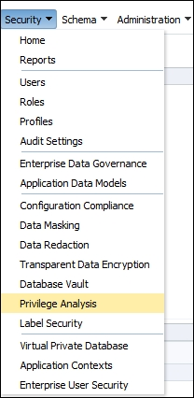
Creating database analysis policy
1
Login to EM as a user who has appropriate privileges and select Privilege Analysis from Security drop-down menu:
Notes:
The choose privilege analysis

Slide 115
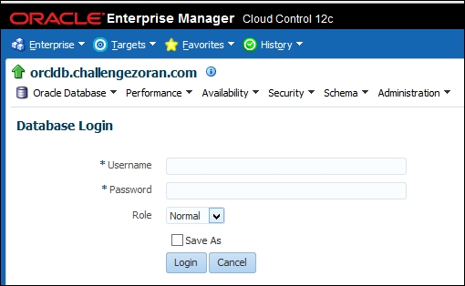
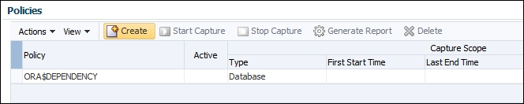
Creating database analysis policy
Log in to the database as SYSTEM user or a user who has appropriate privileges (CAPTURE_ADMIN role and SELECT ANY DICTIONARY privilege).
2
3
Click on the Create button in the Policy section
Notes:
2. The login screen
3. Start the process of creating a privilege analysis policy

Slide 116
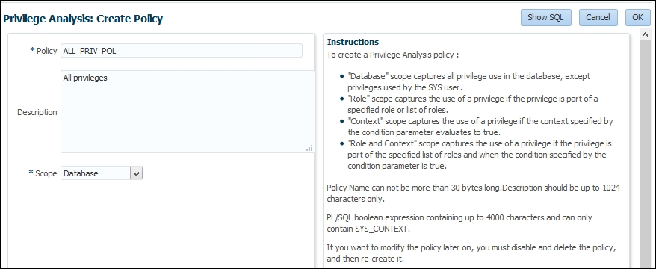
Creating database analysis policy
To create a database policy, choose that scope is Database, name the policy, and optionally write a description. Click on the OK button.
4
Notes:
4. The create policy

Slide 117
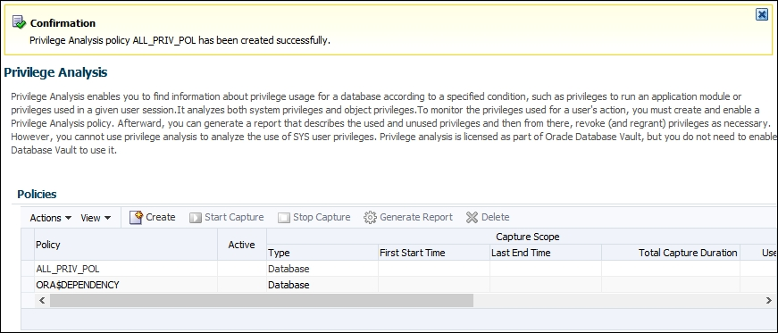
Creating database analysis policy
You should receive a confirmation message and see your newly created policy listed in the table
5
Notes:
A successful message

Slide 118
Creating role analysis policy
You'll create a role analysis policy using SQL*Plus and Enterprise Manager Cloud Control 12c (EM).
The usage of directly and indirectly granted privileges to the roles listed in the policy, will be captured if the roles are active for the session.

Slide 119
Creating role analysis policy
You'll need an existing user who can create a privilege analysis policy (has a CAPTURE_ADMIN role and a SELECT ANY DICTIONARY privilege), for example, SYSTEM user.

Slide 120
Creating role analysis policy
1
Login to EM as a user who has appropriate privileges and select Privilege Analysis from Security drop-down menu:
Log in to the database as SYSTEM user or a user who has appropriate privileges (CAPTURE_ADMIN role and SELECT ANY DICTIONARY privilege).
2
3
Click on the Create button in the Policy section
Notes:
See steps in previous section

Slide 121
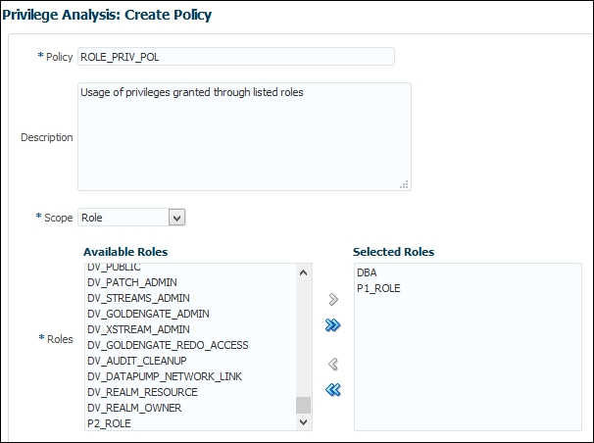
Creating role analysis policy
Name the policy, select roles, optionally write a description, and click on OK button
4
Notes:
Creating a role policy

Slide 122
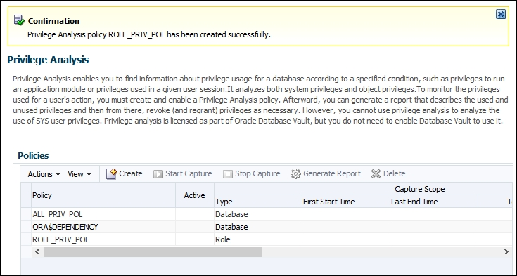
Creating role analysis policy
You should receive a confirmation message and see your newly created policy listed in the table
5
Notes:
The successful creation of the policy

Slide 123
Creating context analysis policy
You'll create a context analysis policy.
After the policy is enabled, it will capture privileges when the condition specified in the policy evaluates to true.
You'll need an existing user who can create a privilege analysis policy (has the CAPTURE_ADMIN role and the SELECT ANY DICTIONARY privilege), for example, the SYSTEM user.

Slide 124
Creating context analysis policy
1
Login to EM as a user who has appropriate privileges and select Privilege Analysis from Security drop-down menu:
Log in to the database as SYSTEM user or a user who has appropriate privileges (CAPTURE_ADMIN role and SELECT ANY DICTIONARY privilege).
2
3
Click on the Create button in the Policy section

Slide 125
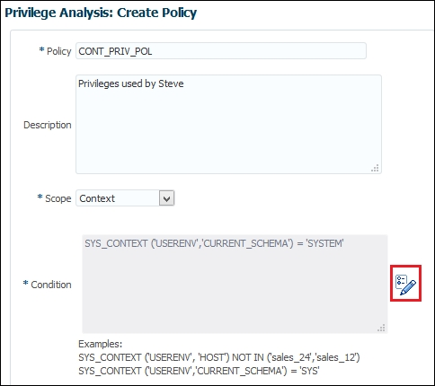
Creating context analysis policy
4
Name the policy and optionally write a description
Notes:
The create context policy

Slide 126
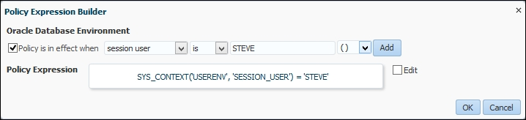
Creating context analysis policy
Click on the Build Context Expression button. You can enter expression manually or use the built-in help. Click on the OK button.
5
Notes:
Build Context Expression button: a pencil icon
enter expression manually: select Edit checkbox
built-in help: select the checkbox Policy is in effect when select appropriate options from drop-down menus, click on the Add button

Slide 127
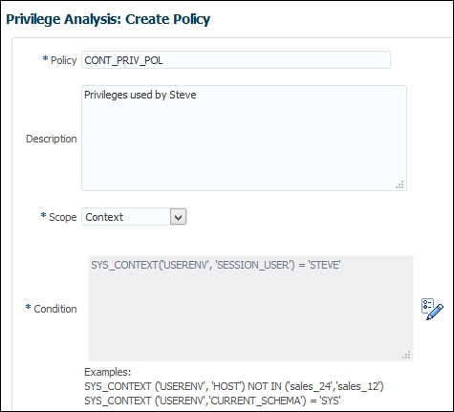
Creating context analysis policy
6
Make sure that you chose options you wanted and then click on the OK button
Notes:
Checking the filled-out context policy

Slide 128
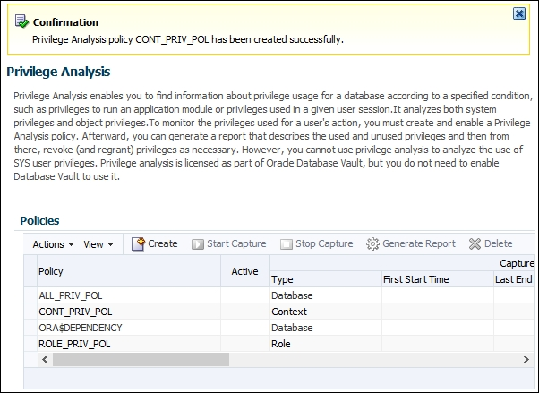
Creating context analysis policy
You should receive a confirmation message and see your newly created policy listed in the table.
7
Notes:
The context policy has been successfully created

Slide 129
Creating combined analysis policy
You'll create a combined analysis policy.
This type of policy defines that the usage of directly and indirectly granted privilege to specified roles will be gathered if roles are enabled in the session and the context condition is satisfied.
The context condition can consist of one or more conditions (you can use the AND or OR Boolean operators).

Slide 130
Creating combined analysis policy
You'll need an existing user who can create a privilege analysis policy (has the CAPTURE_ADMIN role and the SELECT ANY DICTIONARY privilege), for example, the SYSTEM user.

Slide 131
Creating combined analysis policy
1
Login to EM as a user who has appropriate privileges and select Privilege Analysis from Security drop-down menu:
Log in to the database as SYSTEM user or a user who has appropriate privileges (CAPTURE_ADMIN role and SELECT ANY DICTIONARY privilege).
2
3
Click on the Create button in the Policy section

Slide 132
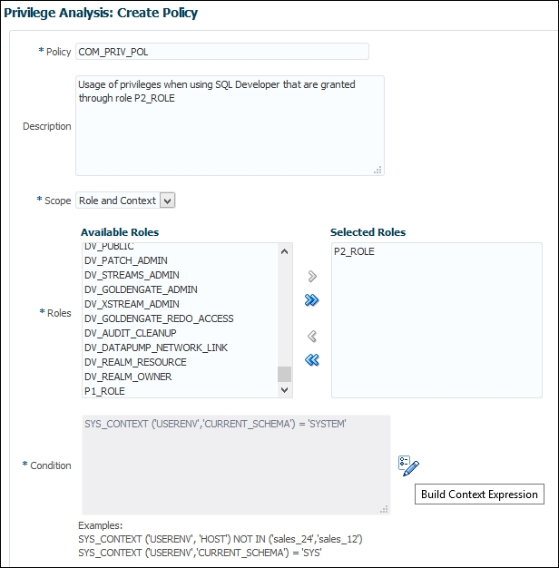
Creating combined analysis policy
Name the policy, select roles, and optionally write a description. Click on Build Context Expression
4
Notes:
Creating the combined policy

Slide 133
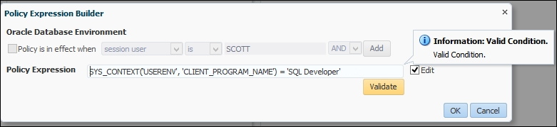
Creating combined analysis policy
Manually write the policy expression. Click on the Validate button and then on the OK button
5
Notes:
Manually write expression in the Policy Expression Builder

Slide 134
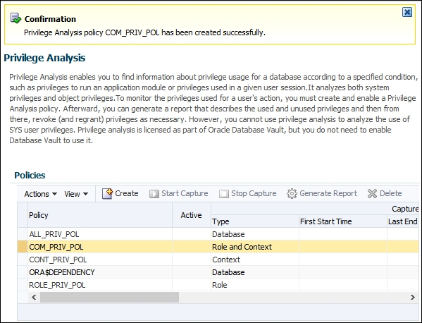
Creating combined analysis policy
6
You should receive a confirmation message and see your newly created policy listed in the table.
Notes:
The successful message

Slide 135
Starting and stopping privilege analysis
To start capturing privileges, you'll enable privilege analysis policies you created previously.
You'll need an existing user who can manage privilege analysis policies (has the CAPTURE_ADMIN role and the SELECT ANY DICTIONARY privilege), for example, the SYSTEM user.

Slide 136
Starting and stopping privilege analysis
Start capturing privileges according to the policy ALL_PRIV_POL.
Then, execute several statements as the user ALAN.
The point of those statements is to generate records.

Slide 137
Starting and stopping privilege analysis
Stop capturing the privilege usage.
Populate DBA_USED_XXX and DBA_UNUSED_XXX data dictionary views.
Notes:
You can see how to use the results of capture later in this chapter.

Slide 138
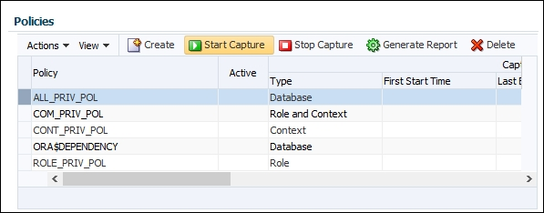
Starting and stopping privilege analysis
1
Login to EM as a user who has appropriate privileges and select Privilege Analysis from Security drop-down menu:
Log in to the database as SYSTEM user or a user who has appropriate privileges (CAPTURE_ADMIN role and SELECT ANY DICTIONARY privilege).
2
3
Select the database policy and click on the Start Capture button
Notes:
3. Enabling a policy

Slide 139
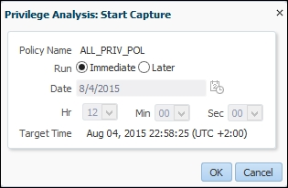
Starting and stopping privilege analysis
4
You can either start capture immediately or schedule it. Leave the defaults and click on the OK button
Notes:
Start capture immediately

Slide 140
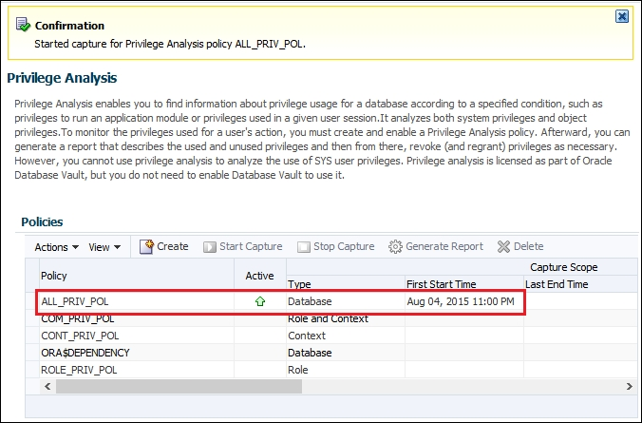
Starting and stopping privilege analysis
You should receive a confirmation message and see that your policy is active
5
Notes:
An active capture

Slide 141

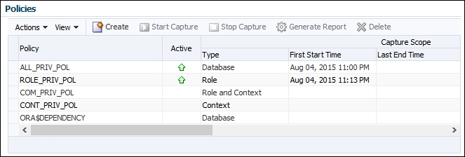
Starting and stopping privilege analysis
6
Select the role policy and click on Start Capture
You should see under the Policies section that both policies are active
7
Notes:
6. Enabling role policy
7. Active policies
Keep in mind that only one policy whose type is Database and one policy whose type is not Database could be active at any given time.

Slide 142
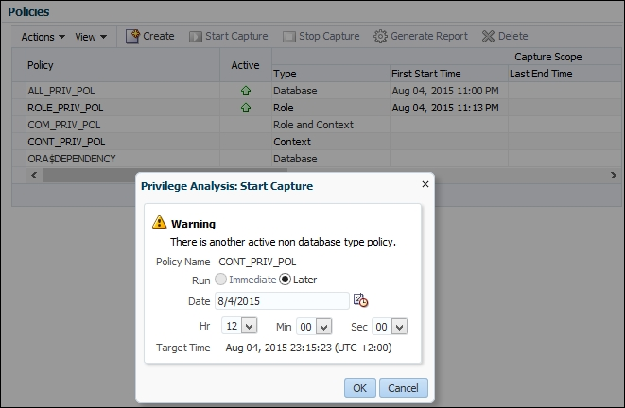
Starting and stopping privilege analysis
Verify that you can't enable another non-database policy while role policy is active. Select CONT_PRIV_POL and click on the Start Capture button. You'll receive warning message, and you'll only be able to schedule job to run at later point in time
8
Notes:
Warning message

Slide 143
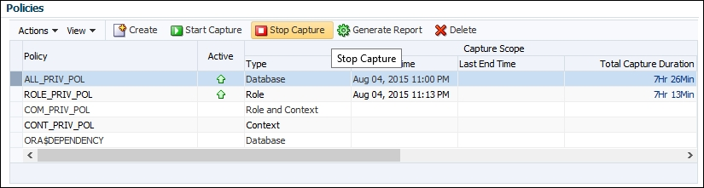
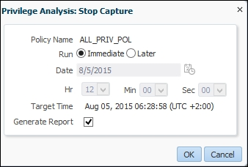
Starting and stopping privilege analysis
To disable capture, select an active policy (for example, ALL_PRIV_POL) and click on the button Stop Capture
9
10
Choose to immediately stop capture and tick generate report checkbox. Click on the OK button
Notes:
9. Stop capture
10. Stop capture and generate report

Slide 144
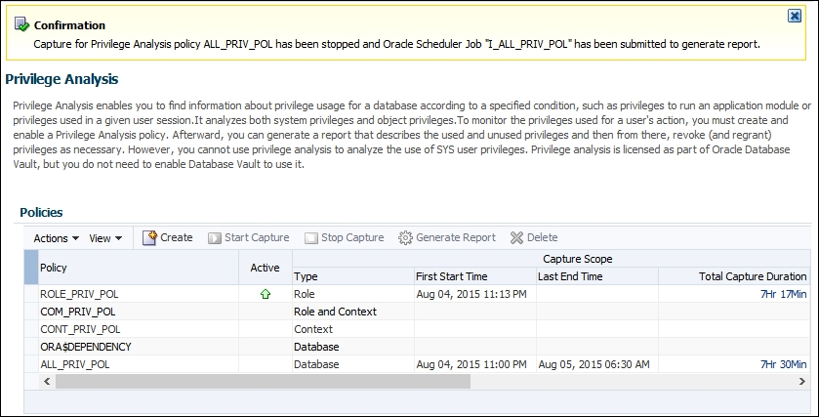
Starting and stopping privilege analysis
You should receive confirmation message that capture has been stopped and that job has been submitted
11
Notes:
Confirmation

Slide 145
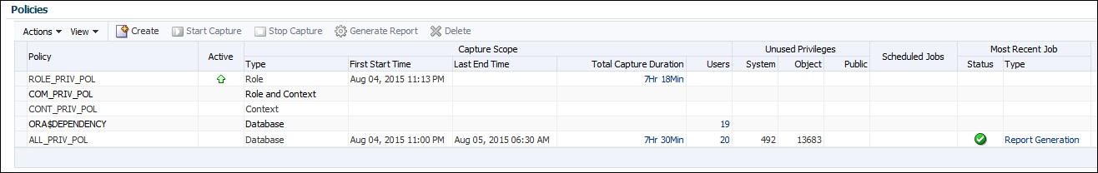
Starting and stopping privilege analysis
12
Refresh page
Notes:
Refresh page (it may take up to several minutes to complete). You should receive result similar to the one shown
12. The generated report
Test all policies you have created in the previous recipes.

Slide 146
Reporting on used system privileges
You'll view collected data about the usage of system privileges during a capture interval.
You'll need an existing user who can create a privilege analysis policy (has the CAPTURE_ADMIN role and the SELECT ANY DICTIONARY privilege), for example, the SYSTEM user.

Slide 147
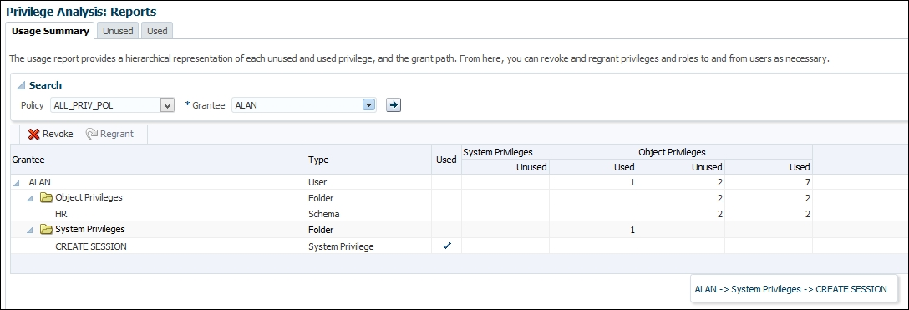
Reporting on used system privileges
In EM 12c, after you have generated the report, select the policy and from Actions drop-down menu, select Reports. The Usage Summary report will open
1
Notes:
1. Usage Summary

Slide 148
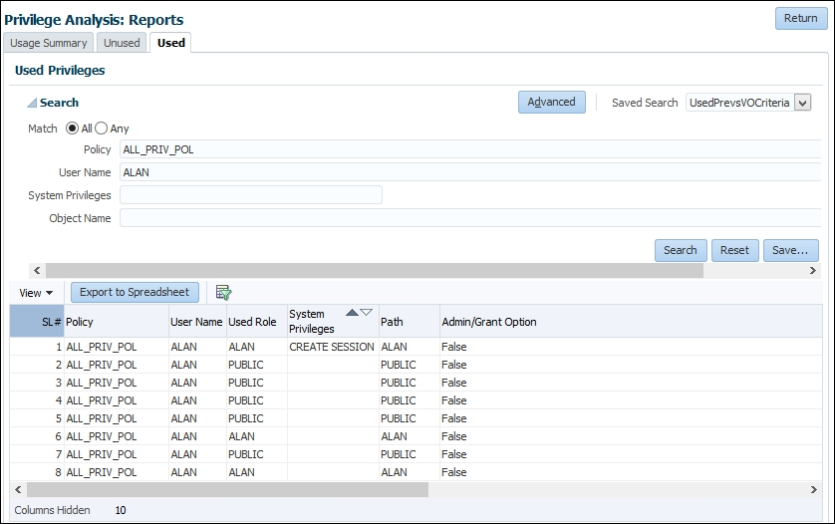
Reporting on used system privileges
Click on the tab Used and choose All for Match radio button, Policy: ALL_PRIV_POL, User Name: ALAN, and click on the Search button.
2
Notes:
Report the used privileges recorded for the user Alan based on the database policy

Slide 149
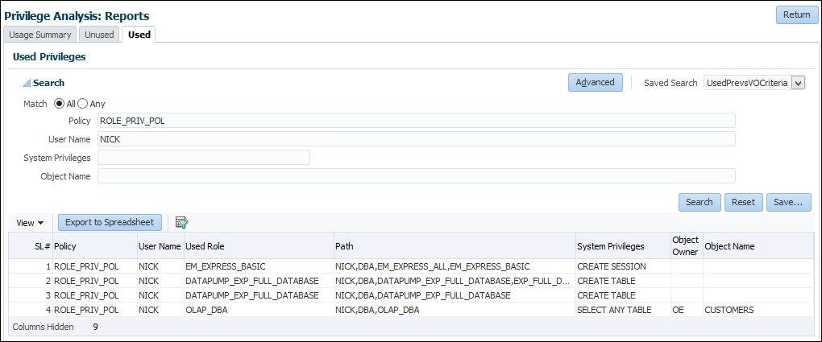
Reporting on used system privileges
If you haven't generated report for the role policy, do it now and return to this tab (the Used tab). Find all records generated by ROLE_PRIV_POL for user Nick (who has a DBA role).
3
Notes:
The used privileges recorded for the user Nick based on role policy

Slide 150
Reporting on used object privileges
You'll view collected data about the usage of object privileges during the capture interval.
You'll need an existing user who can create a privilege analysis policy (has the CAPTURE_ADMIN role and the SELECT ANY DICTIONARY privilege), for example, the SYSTEM user.

Slide 151
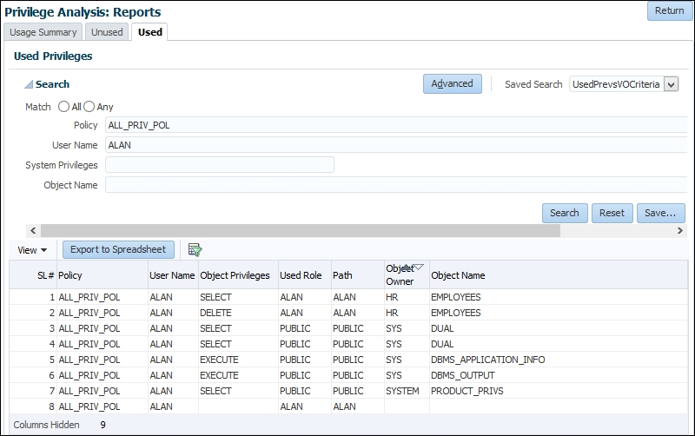
Reporting on used object privileges
In EM 12c, after you have generated the report, select the policy, and from Actions drop-down menu, select Reports. The Usage Summary report will open. Click on the Used tab and verify that the user Alan has used the SELECT and DELETE privileges while ALL_PRIV_POL has been active
1
Notes:
Reports

Slide 152
Reporting on unused system privileges
You'll view the collected data about the unused system privileges during the capture interval.
You'll need an existing user who can create a privilege analysis policy (has the CAPTURE_ADMIN role and the SELECT ANY DICTIONARY privilege), for example, the SYSTEM user.

Slide 153
Reporting on unused system privileges
To view report about the unused system privileges in EM12c, see instructions to view the used system privileges and under Privilege Analysis: Reports, choose the Unused tab instead of the Used tab.

Slide 154
Reporting on unused object privileges
You'll view collected data about the unused object privileges during the capture interval.
You'll need an existing user who can create a privilege analysis policy (has the CAPTURE_ADMIN role and the SELECT ANY DICTIONARY privilege), for example, the SYSTEM user.

Slide 155
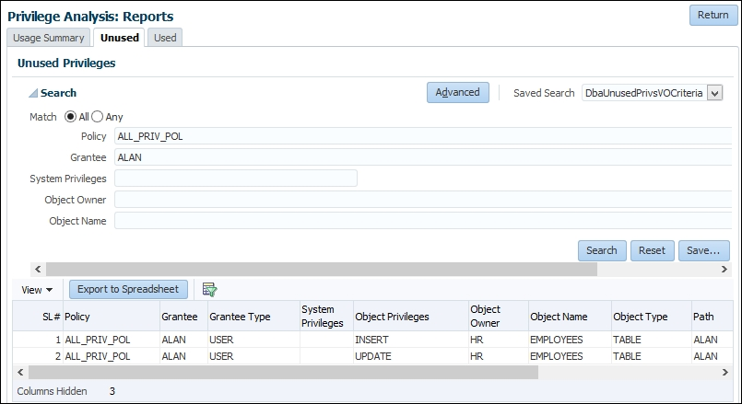
Reporting on unused object privileges
In EM 12c, after you have generated the report, select the policy, and from Actions drop-down menu, select Reports. The Usage Summary report will open. Click on the Unused tab and verify that the user Alan hasn't used the INSERT and UPDATE privileges while ALL_PRIV_POL has been active.
1
Notes:
The Unused object privileges report

Slide 156
How to revoke unused privileges
You can manually revoke unused privileges one by one from users, write your own scripts to complete that task, or use Enterprise Manager Cloud Control 12c.
You'll use EM12c to efficiently revoke unused privileges based on reports you generated in the previous recipes.

Slide 157
How to revoke unused privileges
In EM 12c, there is another excellent option to create a new role based on privilege analysis results.
This way, you won't change an existing role (and affect other users and roles who have that role), but create a new one and afterwards revoke the old role and grant a newly created one.

Slide 158
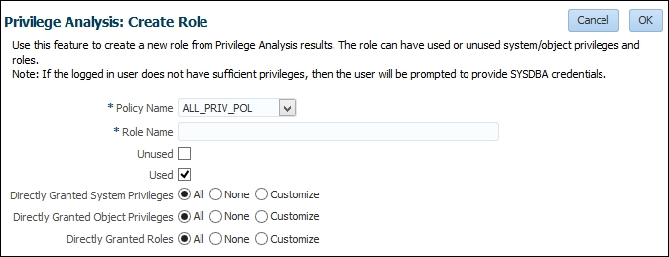
How to revoke unused privileges
You can select it from the Actions menu (Create Role). The configuration part of a process for creating a new role is shown
1
Notes:
Create a new role based on policy

Slide 159
Dropping the analysis
In this recipe, you'll drop an existing privilege analysis policy.
It has to be disabled before dropping; otherwise, you'll receive an error.
You'll need an existing user who can manage privilege analysis policies (has the CAPTURE_ADMIN role and the SELECT ANY DICTIONARY privilege), for example, the SYSTEM user and an existing privilege analysis policy.

Slide 160
Dropping the analysis
In EM 12c under the Policies section, select policy you want to drop and click on the Delete button.

Slide 161
Oracle Database 12c Detective Controls
Unified Auditing

Slide 162
Introduction
In this chapter, we will cover the following tasks:
Enabling the Unified Auditing mode
Configuring whether loss of audit data is acceptable
Which roles do you need to have to be able to create audit policies and to view audit data?
Auditing RMAN operations
Auditing Data Pump operations
Auditing Database Vault operations
Creating audit policies to audit privileges, actions, and roles under specified conditions
Enabling an audit policy
Finding information about audit policies and audited data
Auditing application contexts
Purging audit trail
Disabling and dropping audit policies

Slide 163
Introduction
Unified Auditing is a new feature in Oracle Database 12c, and it introduces new auditing architecture.
Some of the characteristics of unified auditing are:
A single audit trail
Being based on a read-only table
Extensible Audit Framework for additional columns
The separation of audit administration with new roles
Auditing performance is better, especially when used in the queued-write mode

Slide 164
Introduction
Traditional Audit Trails
SYS.AUD$
SYS.FGA_LOG$
V$XML_AUDIT_TRAIL
DBA_COMMON_AUDIT_TRAIL
DVSYS.AUDIT_TRAIL$
OS files
Unified Audit Trails
SYS.UNIFIED_AUDIT_TRAIL
Notes:
Figure 1 depicts that in preunified auditing architecture, there were many audit trails. Now, there is one consolidated unified audit trail, which simplifies management, and auditors can more easily find audited data they are looking for.

Slide 165

Introduction
Unified Auditing Architecture
Audit Policies
SYS.UNIFIED_AUDIT_TRAIL
SELECT, UPDATE, INSERT, …
Database Vault Realm actions
DataPump operations
RMAN Operations
READ-ONLY TABLE

Slide 166
Enabling Unified Auditing mode
In Oracle Database 12c, unified auditing is not enabled by default.
The process of enabling it is simple and equivalent to enabling of other database options.
You'll need to shut down the database.

Slide 167
Enabling Unified Auditing mode
When database is upgraded to 12c, by default, it uses the traditional way of auditing.
However, when you directly install a new database 12c, default auditing is set to mixed auditing mode.
In both cases, the procedure to enable the unified auditing mode is the same.
Notes:
1. (everything like it was in previous versions)

Slide 168
Enabling Unified Auditing mode
After you enable the unified auditing mode, traditional auditing doesn't work anymore.
Old audit instance parameters (AUDIT_TRAIL, AUDIT_FILE_DEST, AUDIT_SYSLOG_LEVEL, and AUDIT_SYS_OPERATIONS) are disregarded.
Predefined unified audit policies that are enabled by default are:
ORA_SECURECONFIG (database versions:12.1.0.1, 12.1.0.2)
ORA_LOGON_FAILURES (Oracle Database 12.1.0.2)
Notes:
Also, using syslog and writing audit records to OS are not supported.

Slide 169
Enabling Unified Auditing mode
Predefined unified audit policies
Predefined audit policy | Oracle Database 12.1.0.1 | Oracle Database 12.1.0.2
ORA_RAS_POLICY_MGMT | Yes | Yes
ORA_DATABASE_PARAMETER | Yes | Yes
ORA_RAS_SESSION_MGMT | Yes | Yes
ORA_ACCOUNT_MGMT | Yes | Yes
ORA_SECURECONFIG | Yes | Yes
ORA_LOGON_FAILURES | No | Yes
ORA_CIS_RECOMMENDATIONS | No | Yes
ORA_DV_AUDPOL | No | Yes
Notes:
A predefined unified audit policy is a named set of commonly used and recommended audit settings, which already exists in Oracle Database 12c. In Oracle Database 12.1.0.1, there are five predefined unified audit policies, whereas there are eight predefined audit policies in Oracle Database 12.1.0.2. Table 1 lists predefined audit policies.
Even though predefined audit policies have the same name in different versions of Oracle Database, it doesn't necessarily mean that they are always identical.

Slide 170
Enabling Unified Auditing mode
If you execute the following statement in both 12.1.0.1 and 12.1.0.2 database versions, as a user who has the audit_admin or dba role:
SQL> select audit_option from audit_unified_policies
where policy_name='ORA_SECURECONFIG'
order by 1;
Notes:
You will note that the ORA_SECURECONFIG predefined unified audit policy is slightly different (for example, audit_options: LOGON, LOGOFF that exist in 12.1.0.1 are removed from the policy in 12.1.0.2 and LOGON is part of ORA_LOGON_FAILURES policy; also some audit options are added in ORA_SECURECONFIG in 12.1.0.2 such as ALTER PLUGGABLE DATABASE).

Slide 171
Enabling Unified Auditing mode
In Oracle Database 12cR1 Standard Edition (SE), when you enable unified auditing mode and query the v$option view to verify that it's enabled you may see the following:
PARAMETER VALUE
---------------- --------
Unified Auditing FALSE
Notes:
This bug has been reported in My Oracle Support (17466854) and patch has been released.

Slide 172
Configuring whether loss of audit data is acceptable
You'll learn to set whether audit data is queued in memory or is immediately written to audit trail.
You'll need an existing user who has the audit_admin role.

Slide 173
Configuring whether loss of audit data is acceptable
The default value for a write mode is the queued-write mode.
In this mode, audit data is stored in SGA queues and later automatically persisted in the read-only table in the AUDSYS schema in the SYSAUX tablespace.
You can also manually flush content of memory queues to the disk:
SQL>EXEC SYS.DBMS_AUDIT_MGMT.FLUSH_UNIFIED_AUDIT_TRAIL;
Notes:
You'll achieve better performance by using the queued-write mode, but in an event of instance crash, you may lose some audit records.
It is recommended that you use the queued-write mode in case that possibility of some audit data loss is acceptable.

Slide 174
Which roles do you need to have to be able to create audit policies and to view audit data?
In this recipe, you're going to create two users (for example, jack and jill).
Jack's job is to implement auditing requirements and to make sure that auditing is functioning properly.
Jill is an auditor and her job is to analyze audit data.
You'll need an existing user who has the DBA role.

Slide 175
Which roles do you need to have to be able to create audit policies and to view audit data?
AUDIT_ADMIN
AUDIT_VIEWER
Manages audit configuration & audit trail.
Analysis audit data.
Notes:
In Oracle Database 12c, there are two new roles: AUDIT_ADMIN and AUDIT_VIEWER (Figure 4).
They enable the separation of duties in the auditing process. To configure auditing, you no longer need to have the dba role or connect as sysdba. From the security perspective, this is a significant improvement.

Slide 176
Which roles do you need to have to be able to create audit policies and to view audit data?
Grant the AUDIT_ADMIN role to the newly created user jack because that role enables him to create, alter, enable, disable, and drop audit policies, view audit data, and manage the unified audit trail.
Grant the AUDIT_VIEWER role to the user jill because that role enables her to view audit data.
Notes:
You may wonder why the AUDIT_ADMIN role is designed in such a way that it enables a user to view audit data. One of the reasons could be that when you configure auditing (for example, create and enable audit policies), you have to be able to verify that audit records are generated in a way you have expected they would.

Slide 177
Which roles do you need to have to be able to create audit policies and to view audit data?
To test what can and can't be done as a user who has the audit_viewer role, connect to the database as jill and try to create the unified audit policy jill_policy:
SQL> connect jill
SQL> create audit policy jill_policy
actions delete on oe.orders;
actions delete on oe.orders
*
ERROR at line 2:
ORA-00942: table or view does not exist

Slide 178
Which roles do you need to have to be able to create audit policies and to view audit data?
Even if you grant object privileges on the oe.orders table to jill, she won't be able to create unified audit policy because she doesn't have the audit_admin role or the AUDIT SYSTEM system privilege:
SQL> conn maja
SQL> grant select,delete on oe.orders to jill;
SQL> connect jill

Slide 179
Which roles do you need to have to be able to create audit policies and to view audit data?
SQL> create audit policy jill_policy
actions delete on oe.orders;
actions delete on oe.orders
*
ERROR at line 2:
ORA-01031: insufficient privileges

Slide 180
Which roles do you need to have to be able to create audit policies and to view audit data?
Revoke select and delete on the oe.orders table from Jill:
SQL> connect maja
SQL> revoke select,delete on oe.orders from jill;
Revoke succeeded.

Slide 181
Which roles do you need to have to be able to create audit policies and to view audit data?
Grant the AUDIT SYSTEM privilege to jill and again try to create the audit policy jill_policy:
SQL> grant audit system to jill;
SQL> connect jill
SQL> create audit policy jill_policy
actions delete on oe.orders;
Audit policy created.

Slide 182
Which roles do you need to have to be able to create audit policies and to view audit data?
Drop the unified audit policy jill_policy and revoke the AUDIT SYSTEM privilege from jill:
SQL> drop audit policy jill_policy;
Audit Policy dropped.
SQL> connect maja
SQL> revoke audit system from jill;

Slide 183
Which roles do you need to have to be able to create audit policies and to view audit data?
View audit data:
Also, a user who has the audit_viewer role can access information about defined and enabled unified audit policies.
SQL> connect jill
SQL> select dbusername, action_name from unified_audit_trail
where unified_audit_policies='ORA_SECURECONFIG';

Slide 184
Which roles do you need to have to be able to create audit policies and to view audit data?
Throughout this chapter, you'll use a user who has the audit_admin role (for example, jack).
So only test you'll do right now is to enable the predefined audit policy ORA_ACCOUNT_MGMT and then to disable it:
SQL> connect jack
SQL> audit policy ora_account_mgmt;
Audit succeeded.
SQL> noaudit policy ora_account_mgmt;
Noaudit succeeded.

Slide 185
Auditing RMAN operations
You'll see that RMAN operations are audited by default.
In this, we assume that database is in the ARCHIVELOG mode.
You'll need an existing user who has the SYSBACKUP privilege (for example, tom) and an existing user who has the dba role (for example, maja).

Slide 186
Auditing RMAN operations
When the mixed or unified auditing mode is enabled, RMAN operations are automatically audited.
Perform the backup of the tablespace EXAMPLE.
Then intentionally cause a problem by removing the datafile.
Afterwards, perform restore and recover RMAN operations.
Notes:
1. This means that you don't create audit policies, but you view and manage audit data in the same way as for other components.

Slide 187
Auditing RMAN operations
The whole point of the example is to execute several RMAN operations.
In the unified_audit_trail data dictionary view, there are several columns that contain data pertaining to the RMAN events.
Their names start with RMAN, so it's easy to find them.

Slide 188
Auditing RMAN operations
You should get similar result to this one:
DBUSERNAME RMAN_OPERATION
----------------- --------------------
TOM Backup
TOM List
TOM Restore
TOM Recover

Slide 189
Auditing Data Pump operations
You can audit Data Pump export, import, or both export and import operations by creating audit policies.
You'll need an existing user who has the audit_admin role (for example, jack).

Slide 190
Auditing Data Pump operations
Also, it is assumed that directory for export operations (for example, my_dir) is created and a user (for example, maja) who is going to perform the Data Pump export has read and write privileges on the directory.
SQL> CREATE DIRECTORY my_dir AS '/u01/app/oracle/oradata/export';
SQL> grant read, write ON DIRECTORY my_dir to maja;

Slide 191
Auditing Database Vault operations
You'll learn to audit Oracle Database Vault events.
You'll need to use Oracle Database 12c, which has Oracle Database Vault enabled and at least some of the components configured.
Also, you'll need an existing user who has the audit_admin role.
Notes:
2. for example, the realm HR realm and rule set Working Hours

Slide 192
Auditing Database Vault operations
To create an audit policy that captures Oracle Database Vault events, specify ACTIONS COMPONENT = DV <action> ON <object>.
Define the audit policy dbv_policy that encapsulates the rules.
In the unified audit trail, Oracle Database Vault-specific audit data is stored in the columns whose name starts with DV_.
Notes:
2. rules: audit records should be generated when somebody tries to access protected objects during nonworking hours or when unauthorized person tries to access objects secured by HR Realm.

Slide 193
Auditing Database Vault operations
When you are using Oracle Database Vault, you can also additionally secure your auditing infrastructure by creating a realm around the AUDIT_ADMIN and AUDIT_VIEWER roles.
This allows you to control who can grant those roles.

Slide 194
Creating audit policies to audit privileges, actions and roles under specified conditions
You will create several unified audit policies.
You'll need two existing users:
A user who has the audit_admin role (for example, jack)
A user who has the create session privilege (for example, john)

Slide 195
Creating audit policies to audit privileges, actions and roles under specified conditions
Also, you should create the roles hr_role and oe_role as stated here and grant hr_role to the user john.
SQL> create role hr_role;
SQL> grant select any table, create table to hr_role;
SQL> grant insert on hr.departments to hr_role;
SQL> create role oe_role;
SQL> grant drop any table to oe_role;
SQL> grant select, update on oe.orders to oe_role;
SQL> grant oe_role to hr_role;
SQL> grant hr_role to john;

Slide 196
Creating audit policies to audit privileges, actions and roles under specified conditions
When you create a unified audit policy, it is stored in the first-class object owned by SYS schema.
Create the audit policy my_policy1.
Create the audit policy role_con_policy.
Notes:
According to the official Oracle documentation, Oracle Database Security Guide 12c, E48135-09, p.22-4
Audit records generation, as defined in a unified audit policy, starts after you enable the policy.
3. which defines that audit records will be generated when a user is connected to the database from the specified host (dbhost.orapassion.com) and system privileges that are directly granted to HR_ROLE are used.

Slide 197
Creating audit policies to audit privileges, actions and roles under specified conditions
The Role HR_ROLE has to exist at the time audit policy role_con_policy is created because if it doesn't exist you will get an error message:
Create the audit policy hr_policy, the way it is written, audit records will be generated for select, insert, and update operations on all objects and for delete operations on hr.departments.
ERROR at line 2:
ORA-01919: role 'HR_ROLE' does not exist
Notes:
A common pitfall: People often define object-wise audit policies, (<object_action_1>, <object_action_2>, ...,<object_action_n> ON <object>). However, in most cases, the behavior they really want to get should be defined by writing <object_action_1> ON <object>, <object_action_2> ON <object>,...,<object_action_n> ON <object>.

Slide 198
Creating audit policies to audit privileges, actions and roles under specified conditions
Create the audit policy oe_policy, which will be used in order to audit all actions on table orders in oe schema.
In Oracle Database 12.1.0.1 due to the bug, audit records for this policy are not generated.
Workaround is to specify one by one actions instead of using keyword ALL.
Notes:
2. (16714031- Audit policy using actions all does not record audit trails (MOS))
3. The bug is fixed in Oracle Database 12.1.0.2.

Slide 199
Enabling audit policy
You will learn to use different options to enable unified audit policies.
You'll need an existing user who has the audit_admin role (for example, jack) and several other existing users (for example, john, maja, and zoran).

Slide 200
Enabling audit policy
Define BY list, which means that only user(s) listed on that list will be affected by the policy.
Define that audit policy hr_policy is applied to all users, but only successful operations will generate audit records.
Define EXCEPT list.
Notes:
3. Except list: which means that listed users will not be affected by audit policy. Also, audit records will be generated only for the failed operations.

Slide 201
Enabling audit policy
Enable audit policy using default options, which means that role_con_policy will affect all users for both successful and unsuccessful events.
You can't use both BY and EXCEPT lists for the same policy statement.

Slide 202
Finding information about audit policies and audited data
You will view audited data and find information about unified audit policies.

Slide 203
Finding information about audit policies and audited data
You'll need three existing users:
Also, you'll need to connect to the database as SYS user.
A user who has audit_admin role (for example, jack)
A user who has hr_role and oe_role (for example, john), created in recipe Creating audit policies to audit privileges, actions and roles under specified conditions
A user who has admin_viewer role (for example, jill)

Slide 204
Auditing application contexts
You will configure auditing of information contained in an application context.
You'll need an existing (or predefined) application context and a user who has the audit_admin role (for example, jack).

Slide 205
Auditing application contexts
Audit custom application contexts:
NAMESPACE ATTRIBUTE USER_NAME
---------- ------------ -------------
USERENV HOST JILL
USERENV SERVICE_NAME ALL USERS
USERENV SESSION_USER ALL USERS
Notes:
You can audit custom application contexts (for example, the ones you created) in the same way.

Slide 206
Auditing application contexts
If needed, execute the following statement as the user jack:
SQL>EXEC SYS.DBMS_AUDIT_MGMT.FLUSH_UNIFIED_AUDIT_TRAIL;

Slide 207
Auditing application contexts
Audit records:
APPLICATION_CONTEXTS
--------------------------------------------------------------
(USERENV,SERVICE_NAME=SYS$USERS); (USERENV,SESSION_USER=JACK)
(USERENV,SERVICE_NAME=SYS$USERS); (USERENV,SESSION_USER=JILL);
(USERENV,HOST= dbhost.orapassion.com)

Slide 208
Auditing application contexts
To disable auditing of application contexts, you should use the NOAUDIT command:
SQL> connect jack
SQL> NOAUDIT CONTEXT NAMESPACE USERENV
ATTRIBUTES HOST BY jill;

Slide 209
Purging audit trail
You can clean up audit data manually or by scheduling clean up job.
You'll need a user who has the audit_admin role (for example, jack).

Slide 210
Purging audit trail
By default, USE_LAST_ARCH_TIMESTAMP is set to TRUE.
It means that only records created before that time will be deleted.
If you set that parameter to FALSE, all records will be deleted.
Notes:
2. It is recommended to use the default value.

Slide 211
Purging audit trail
In multitenant environment, use CONTAINER clause as well (CONTAINER => DBMS_AUDIT_MGMT.CONTAINER_CURRENT or DBMS_AUDIT_MGMT.CONTAINER_ALL).

Slide 212
Disabling and dropping audit policies
You will learn to disable and drop audit policies.
You'll need an enabled unified audit policy (for example, oe_policy) and a user who has the audit_admin role (for example, jack).

Slide 213
Disabling and dropping audit policies
Check that the audit policy oe_policy is enabled.
Disable it.
To be able to drop audit policy, you have to disable it first.
Drop the audit policy oe_policy.
Notes:
When you disable audit policy, make sure that in the NOAUDIT statement, a list of users (BY or EXCEPT) is the same as it was in the AUDIT statement. If when you disable it, you omit BY JOHN, audit records will continue to be generated.

Slide 214
Oracle Database 12c Detective Controls
Database Vault

Slide 215
Introduction
We will cover the following tasks:
Registering Database Vault
Preventing users from exercising system privileges on schema objects
Securing roles
Preventing users from executing a specific command on a specific object
Creating a rule set
Creating a secure application role
Using Database Vault to implement that administrators cannot view data
Running Oracle Database Vault reports
Disabling Database Vault
Re-enabling Database Vault

Slide 216
Introduction
You are going to learn to create and appropriately use realms, rules, rule sets, command rules, factors, and secure application roles.
Notes:
Introduction of Oracle Database Vault in 2005 brought a major change in the way security is enforced.
Today, 10 years after it was introduced, it remains the most significant tool to control data access and enforce separation of duties in Oracle Database.
From licensing viewpoint, it is only available as an option for Oracle Database Enterprise Edition.
Basic concepts are covered in this chapter, whereas doing everyday administration tasks in Database Vault environment.

Slide 217
Introduction
We assume that database is up and running, and each user has at least create session a privilege.
Also, you will use Oracle Enterprise Manager Cloud Control 12c.
A SYS user, because he is the most powerful user, will be used to test that security is correctly enforced (even for him).
Notes:
techniques are tested on Oracle Database 12.1.0.2 in multitenant environment.

Slide 218
Registering Database Vault
In Oracle Database 12c process of configuring and enabling Database Vault is different than in Oracle Database 11g.
You will learn to register Oracle Database Vault in multitenant environment in two situations:
When Oracle Database 12c is already installed
During the installation of Oracle Database 12c

Slide 219
Registering Database Vault
You'll need an existing common user who has a privilege to create users and grant create session and set container privileges (for example, c##maja).

Slide 220
Registering Database Vault
After you register Oracle Database Vault with Oracle Database 12c, there are number of changes in the Oracle Database.
Some database parameters change values, separation of duties is enabled by revoking privileges from some roles and by creating new users.

Slide 221
Registering Database Vault
You use Database Configuration Assistant (DBCA) when you configure Database Vault during the database installation.
When you get to Database Options, click on tab Database Vault & Label Security.
Select both available checkboxes and fill out text fields to create users: Database Vault Owner and Account Manager.
Notes:
You should complete the rest of the installation in the same way you usually do.

Slide 222

Registering Database Vault
Using DBCA to register

Slide 223
Preventing users from exercising system privileges on schema objects
To prevent users to exercise system privileges (such as select any table), you are going to first create a realm and then you are going to change it to a mandatory realm.
The mandatory realm further restricts access to protected objects.
Schema owners and users with object privileges cannot access mandatory realm-secured objects if they are not authorized in realm.

Slide 224
Preventing users from exercising system privileges on schema objects
You'll need an existing common user who has a DBA role in the pluggable database PDB1 (for example, c##ernesto).

Slide 225
Preventing users from exercising system privileges on schema objects
The difference between participant and owner of the realm is that a realm participant can only exercise system privileges on realm-secured objects.
Whereas an owner besides that can grant object privileges on realm-secured objects to other users and roles.

Slide 226
Preventing users from exercising system privileges on schema objects
Verify that the SYS user can't create a user, after Database Vault is registered:
SQL> connect sys@pdb1 as sysdba
Enter password:
Connected.
SQL> create user usr1 identified by oracle;
create user usr1 identified by oracle
*
ERROR at line 1:
ORA-01031: insufficient privileges

Slide 227
Preventing users from exercising system privileges on schema objects
Verify that after you created realm HR_Realm, the SYS user can't access data in the table HR.EMPLOYEES.
SQL> connect sys@pdb1 as sysdba
Enter password: Connected.
SQL> select count(*) from hr.employees;
select count(*) from hr.employees
*ERROR at line 1:
ORA-01031: insufficient privileges

Slide 228
Preventing users from exercising system privileges on schema objects
This is the expected behavior because realm protects secured objects from users who try to use their system privileges.
In our example, SYS tried to use SELECT ANY TABLE, and because he doesn't have direct object privilege (SELECT on HR.EMPLOYEES), he is restricted from selecting data in the table HR.EMPLOYEES.

Slide 229
Preventing users from exercising system privileges on schema objects
SQL> conn c##ernesto@pdb1
Enter password: Connected.
SQL> select count(*) from hr.employees;
COUNT(*)
---------- 107

Slide 230
Preventing users from exercising system privileges on schema objects
After mandatory realm is created, the user usr1 can't access data in the table HR.EMPLOYEES because he/she is not authorized in the realm.
SQL> connect usr1@pdb1
Enter password:
Connected.
usr1@CDB1> select count(*) from hr.employees;
select count(*) from hr.employees
*
ERROR at line 1:
ORA-01031: insufficient privileges

Slide 231
Preventing users from exercising system privileges on schema objects
The same principle applies even to the schema owner (HR)
SQL> connect usr1@pdb1
SQL> connect hr@pdb1
Enter password:
Connected.
SQL> select count(*) from hr.employees;
select count(*) from hr.employees
*
ERROR at line 1:
ORA-01031: insufficient privileges

Slide 232
Securing roles
In Preventing users from exercising system privileges on schema objects, you secured the table HR.EMPLOYEES by creating the HR_Realm realm, and afterwards, you edit it and made it mandatory.
You'll learn to protect roles using a realm and a mandatory realm.
You'll need to use a SYS user

Slide 233
Securing roles
After we created a realm, the SYS user (or any user that is not authorized in realm) cannot grant the realm-protected role:
SQL> connect usr1@pdb1
SQL> connect hr@pdb1
SQL> connect sys@pdb1 as sysdba
Enter password:
Connected.
SQL> grant role1 to usr1;
grant role1 to usr1
*
ERROR at line 1:
ORA-47410: Realm violation for GRANT on ROLE1

Slide 234
Securing roles
However, user c##ernesto is authorized in realm as owner, so he can grant this role:
SQL> connect c##ernesto@pdb1
Enter password:
Connected.
SQL> grant role1 to usr1;
Grant succeeded.

Slide 235
Securing roles
The SYS user can grant or revoke privileges from role even though the role is protected by realm.
After we make the realm mandatory, this is no longer possible:
SQL> connect sys@pdb1 as sysdba
Enter password:
Connected.
SQL> revoke drop any synonym from role1;
revoke drop any synonym from role1
*
ERROR at line 1:
ORA-47410: Realm violation for REVOKE on ROLE1
SQL> grant update any table to role1;
grant update any table to role1
*
ERROR at line 1:
ORA-47410: Realm violation for GRANT on ROLE1

Slide 236
Preventing users from executing specific command on specific object
You'll learn to create command rules.
A command rule defines a protected database operation on a specific database object (for example, UPDATE on all tables in HR schema).
The evaluation of associated rule set determines if statement will be allowed (executed) or blocked.

Slide 237
Preventing users from executing specific command on specific object
In order to execute UPDATE on the table ORDERS in schema OE, rule set Disabled needs to evaluate TRUE.
However, because rule set DISABLED will evaluate FALSE always, consequently, this command is disabled for all users in the database:
SQL> connect sys@pdb1 as sysdba
Enter password:
Connected.
SQL> UPDATE OE.ORDERS SET ORDER_MODE = 'TEST' WHERE ORDER_ID < 3000;
UPDATE OE.ORDERS SET ORDER_MODE = 'TEST' WHERE ORDER_ID < 3000
*
ERROR at line 1:
ORA-01031: insufficient privileges
Notes:
Command rules can be understood this way: In order to execute command X on object Y in schema Z, rule set with name A needs to evaluate TRUE.

Slide 238
Creating a rule set
A rule set is a group of rules, which will be evaluated as a whole, using only AND or only OR operator.
The Boolean result of logical evaluation is used in other Oracle Database Vault components to grant or deny certain actions (for example, deleting data from a table).
You'll learn to create rules and rule sets.
You are going to use Enterprise Manager Cloud Control 12c.

Slide 239
Creating a rule set
To use rule set you have created in this, create command rule for UPDATE operation on schema SCOTT, table EMP.
And choose that condition for evaluation whether update operation will be executed is defined by rule set Working Hours.

Slide 240

Creating a rule set
Create command rule using your rule set

Slide 241
Creating a rule set
Check time and day (your result will be different).
In this case, it's NOT a work day, so rule set will evaluate to false.
SQLSQL> !date
Sun Jun 14 02:12:02 CEST 2015

Slide 242
Creating a rule set
Try to increase salary by 300 for the employee whose empno is 7902
SQL> UPDATE SCOTT.EMP SET SAL = SAL + 300 WHERE EMPNO = 7902;
UPDATE SCOTT.EMP SET SAL = SAL + 300 WHERE EMPNO = 7902
*
ERROR at line 1:
ORA-01031: insufficient privileges

Slide 243
Creating a rule set
Check time and day (your result will be different).
In this case, it is a work day and it is during working hours, so rule set will evaluate to true
SQL> !date
Mon Jun 15 14:27:24 CEST 2015
SQL> UPDATE SCOTT.EMP SET SAL = SAL + 300 WHERE EMPNO = 7902;
1 row updated.

Slide 244
Creating a secure application role
A secure application role is a database role whose enablement depends on the evaluation of a specified condition.
You'll learn to create secure application role using Oracle Database Vault.
The condition that determines whether the role will be enabled is specified by rule set (you can use built-in rule set or create your own).

Slide 245
Creating a secure application role
You are going to test behavior of the secure application role.
Connect to pluggable database pdb1 as a user who has the Oracle Database Vault Account Manager role and create the user usr2.
SQL> connect c##dbv_acctmgr/oraDVA123@pdb1
Connected.
SQL> create user usr2 identified by oracle1;
User created.

Slide 246
Creating a secure application role
Connect to the pluggable database pdb1 as a SYS user and grant a create session privilege to usr2 and select and update privileges to the role cust_role
SQL> connect sys/oracle@pdb1 as sysdba
Connected.
SQL> grant create session to usr2.
Grant succeeded.
SQL> grant select on oe.customers to cust_role;
Grant succeeded.
SQL> grant update on oe.customers to cust_role;
Grant succeeded.

Slide 247
Creating a secure application role
Connect to pluggable database pdb1 as usr2 and view information about machine you are accessing the database from.
In this example, we are using a built-in factor to get that information.
SQL> connect usr2/oracle1@pdb1
SQL> select dvf.f$machine from dual;
F$MACHINE
------------------------------------------------
host01.challengeernesto.com
Notes:
If you want to learn more about factors in Oracle Database Vault.

Slide 248
Creating a secure application role
Set cust_role by using the PL/SQL package DBMS_MACSEC_ROLES:
SQL> EXEC DBMS_MACSEC_ROLES.SET_ROLE('CUST_ROLE');
PL/SQL procedure successfully completed.

Slide 249
Creating a secure application role
View number of rows in the table OE.CUSTOMERS:
When the same user tries to connect from another machine, he or she won't be able to set the role, which in turn means that he or she won't be able to view data in the table OE.CUSTOMERS:
SQL> select count(*) from oe.customers;
COUNT(*)
----------
319

Slide 250
Creating a secure application role
SQL> connect usr2/oracle1@pdb1
Connected.
SQL> select dvf.f$machine from dual;
F$MACHINE
---------------------------------------------------
host02.challengezoran.com
SQL> EXEC DBMS_MACSEC_ROLES.SET_ROLE('CUST_ROLE');
BEGIN DBMS_MACSEC_ROLES.SET_ROLE('CUST_ROLE'); END;
*
ERROR at line 1:
ORA-47305: Rule Set violation on SET ROLE (CUST_ROLE)
ORA-06512: at "DVSYS.DBMS_MACUTL", line 49
ORA-06512: at "DVSYS.DBMS_MACUTL", line 398
ORA-06512: at "DVSYS.DBMS_MACSEC", line 306
ORA-06512: at "DVSYS.ROLE_IS_ENABLED", line 4
ORA-06512: at "DVSYS.DBMS_MACSEC_ROLES", line 55
ORA-06512: at line 1
SQL> select count(*) from oe.customers;
select count(*) from oe.customers
*
ERROR at line 1:
ORA-00942: table or view does not exist

Slide 251
Using Database Vault to implement that administrators cannot view data
You will use multiple components (realms, command rules, and rule sets) to secure data in database from administrators.

Slide 252
Using Database Vault to implement that administrators cannot view data
We can show that the user orders_dba in fact can manage objects in OE schema (for instance, he can create and drop a table test)
This is because he is authorized in realm that protects oe schema:
SQL> connect orders_dba@pdb1
Enter password:
Connected.
SQL> create table oe.test(a int);
Table created.
SQL> drop table oe.test;
Table dropped.

Slide 253
Using Database Vault to implement that administrators cannot view data
However, the user orders_dba cannot view data that resides inside objects in OE schema
Select on objects in this schema is restricted to users that have the role ORD_USR_ROLE using command rule:
SQL> select count(*) from oe.orders;
select count(*) from oe.orders
*
ERROR at line 1:
ORA-01031: insufficient privileges

Slide 254
Using Database Vault to implement that administrators cannot view data
The user orders_user has the role ORD_USER_ROLE and he or she can select data from table in OE schema:
SQL> connect orders_user@pdb1
Enter password:
Connected.
SQL> select count(*) from oe.orders;
COUNT(*)
----------
105

Slide 255
Using Database Vault to implement that administrators cannot view data
An example of adding a new user to the system and authorizing him to access the data:
Because separation of duties is implemented, there are several users that need to grant certain privileges.

Slide 256
Using Database Vault to implement that administrators cannot view data
Only account manager can create users in database:
SQL> connect c##dbv_acctmgr@pdb1
Enter password:
Connected.
SQL> create user orders_user2 identified by oracle3;
User created.

Slide 257
Using Database Vault to implement that administrators cannot view data
The SYS user is one of the few users who are authorized to grant a create session privilege
SQL> connect sys@pdb1 as sysdba
Enter password:
Connected.
SQL> grant create session to orders_user2;
Grant succeeded.
Notes:
(after Database Vault is implemented, users with the DBA role cannot grant the create session privilege, unless they are authorized in Database Vault)

Slide 258
Using Database Vault to implement that administrators cannot view data
Because c##ernesto is the only authorized user in realm that protects the role ORD_USR_ROLE
He is the only user that can grant that role:
SQL> connect c##ernesto@pdb1
Enter password:
Connected.
SQL> grant ord_usr_role to orders_user2;
Grant succeeded.

Slide 259
Using Database Vault to implement that administrators cannot view data
Orders_dba is the only user that is authorized in realm that protects OE schema, so he is the only user that can grant object privileges on objects in OE schema.
SQL> connect orders_dba@pdb1
Enter password:
Connected.
SQL> grant select on oe.orders to orders_user2;
Grant succeeded.
SQL> grant update on oe.orders to orders_user2;
Grant succeeded.

Slide 260
Using Database Vault to implement that administrators cannot view data
After a user is granted all necessary privileges, he or she is able to connect to the database and select data from table in secured schema.
SQL> connect orders_user2@pdb1
Enter password:
Connected.
SQL> select count(*) from oe.orders;
COUNT(*)
---------
105

Slide 261
Running Oracle Database Vault reports
You will intentionally violate some security controls in order to have data for reports.

Slide 262
Disabling Database Vault
You will disable Database Vault in two ways: Using Enterprise Manager 12c Cloud Control and command line.

Slide 263
Re-enabling Database Vault
You will enable previously disabled Database Vault in two ways: Using Enterprise Manager 12c Cloud Control and command line.

Slide 264
Oracle Database 12c Detective Controls
Database Vault and Data Pump

Slide 265
Introduction
In this chapter, we will cover the following tasks:
Exporting data using Oracle Data Pump in the Oracle Database Vault environment
Creating factors in Oracle Database Vault
Using TDE in a multitenant environment

Slide 266
Introduction
An Oracle Database Vault component factor is a named variable, which can have one or more values, assigned in several ways.
The actual value of factor is named identity.
Each factor has a factor type.

Slide 267
Introduction
A factor type is used only for classification purposes.
Factors are building blocks for configuring security policies.
They can be used in rules/rule sets.
You can configure factors by using Oracle Enterprise Manager or the Database Vault API.

Slide 268
Exporting data using Oracle Data Pump in Oracle Database Vault environment
In Oracle Database 12c, it is possible to perform Oracle Data Pump regular and transportable export and import operations in the Oracle Database Vault environment.
You'll export data that resides in a schema that is protected by a realm.
Notes:
The process of exporting and importing data in Oracle Database 12c is a bit different than in Oracle Database 11g. The default rule set Allow Oracle Data Pump Operation is deprecated.

Slide 269
Exporting data using Oracle Data Pump in Oracle Database Vault environment
It is assumed that:
You are using Oracle Database 12.1.0.2 (the traditional architecture) on Linux
Sample schemas are installed (you'll use HR schema in this recipe)
Database Vault is enabled and configured (a Database Vault owner is user dbv_owner, account manager is user dbv_acctmgr, and realm that protects HR schema is created).

Slide 270
Exporting data using Oracle Data Pump in Oracle Database Vault environment
This is one way how you can create HR realm:
SQL> connect dbv_owner
SQL> BEGIN
DBMS_MACADM.CREATE_REALM(
realm_name => 'HR Realm',
description => 'Protects HR schema',
enabled => DBMS_MACUTL.G_YES,
audit_options => DBMS_MACUTL.G_REALM_AUDIT_OFF,
realm_type => 0);
END;
/
PL/SQL procedure successfully completed.
Notes:
The parameter realm_type specifies whether realm is a mandatory realm or not. Allowed values, for the parameter, are 0 (realm) and 1 (mandatory realm).

Slide 271
Exporting data using Oracle Data Pump in Oracle Database Vault environment
SQL> BEGIN
DBMS_MACADM.ADD_OBJECT_TO_REALM(
realm_name => 'HR Realm',
object_owner => 'HR',
object_name => '%',
object_type => '%');
END;
/
PL/SQL procedure successfully completed.

Slide 272
Exporting data using Oracle Data Pump in Oracle Database Vault environment
A directory for export operations (for example, dp_dir) is created and a user (for example, piter) who is going to perform Data Pump export has read and write privileges on the directory.
Also, the DATAPUMP_EXP_FULL_DATABASE role and the CREATE TABLE and UNLIMITED TABLESPACE privileges have been granted to the user:

Slide 273
Exporting data using Oracle Data Pump in Oracle Database Vault environment
SQL> connect system
SQL> CREATE DIRECTORY dp_dir AS '/u01/app/oracle/oradata/dp_exp';
SQL> connect dbv_acctmgr
SQL> create user piter identified by T2abc_4z1;
SQL> grant create session to piter;
SQL> connect / as sysdba
SQL> grant create table, unlimited tablespace to piter;
SQL> grant read, write ON DIRECTORY dp_dir to piter;
SQL> grant DATAPUMP_EXP_FULL_DATABASE to piter;

Slide 274
Exporting data using Oracle Data Pump in Oracle Database Vault environment
To be able to export data that is protected by Database Vault mechanisms, user has to be authorized.
You can authorize a user to perform export and import operations:
On specific database object in a schema, such as table.
SQL> EXEC DBMS_MACADM.AUTHORIZE_DATAPUMP_USER ('AMY', 'HR',
'EMPLOYEES');
Notes:
(besides having appropriate privileges to perform Data Pump operations, for example, the role)
1. For example, it authorizes the user amy to export the table HR.EMPLOYEES:

Slide 275
Exporting data using Oracle Data Pump in Oracle Database Vault environment
On specific schema.
For entire database.
SQL> EXEC DBMS_MACADM.AUTHORIZE_DATAPUMP_USER ('KIM');
SQL> grant DV_OWNER to kim;
Notes:
2. (you authorized the user piter to perform export and import operations on HR schema).
3. For example, it authorizes the user kim to export and import database object for the entire database:

Slide 276
Exporting data using Oracle Data Pump in Oracle Database Vault environment
If you want to encrypt Oracle Data Pump export, using its encryption features, Oracle Advanced Security option has to be enabled.
To encrypt export, specify appropriate value for ENCRYPTION parameter.
These are allowed values for the parameter:
ENCRYPTION=[ALL|DATA_ONLY|ENCRYPTED_COLUMNS_ONLY|METADATA_ONLY|NONE]
Notes:
According to Oracle Database Licensing Information, 12c Release 1 (12.1),
(instead of NONE which was shown in step 6 in the How to do it section)
Also, before starting an export operation, make sure that the keystore is open.

Slide 277
Creating factors in Oracle Database Vault
You'll create three factors (Day, Holiday, and NonWorkingDay).
The factor Day will return name of the day based on sysdate.
Notes:
The factor Holiday will return TRUE if it is a company nonworking holiday (for example, 1-JAN, 4-JUL, and 15-NOV) and FALSE otherwise. The factor NonWorkingDay will return whether it's a nonworking day (NO, WEEKEND, and COMPANY_HOLIDAY). We'll assume that a day is a nonworking day if it is a weekend or a company nonworking holiday (in case it is both weekend and holiday, it should resolve it to COMPANY_HOLIDAY).

Slide 278
Creating factors in Oracle Database Vault
It is assumed that:
The user dbv_owner has been granted the SELECT ANY DICTIONARY privilege
You are using Oracle Database 12.1.0.2 (the traditional architecture) on Linux and Oracle Enterprise Manager Cloud Control 12c
Database Vault is enabled and configured (the Database Vault owner is the user dbv_owner and account manager is the user dbv_acctmgr).

Slide 279
Creating factors in Oracle Database Vault
The user piter exists, the function piter.get_function has been created, and DVSYS has been granted the EXECUTE privilege on the function:
SQL> connect system
SQL> create or replace function piter.get_holiday
2 return varchar2
3 IS
4 holiday varchar2(10);
5 begin
6 IF (RTRIM(TO_CHAR(SYSDATE,'DD-MON')) IN ('1-JAN', '4-JUL',
'15-NOV')) THEN
7 holiday := 'TRUE';
8 ELSE
9 holiday := 'FALSE';
10 END IF;
11 RETURN holiday;
12 end;
13 /
Function created.
SQL> grant execute on piter.get_holiday to dvsys;
Grant succeeded.
Notes:
Results in this recipe are shown for the situation that, at the same time, it is SUNDAY and it is a holiday.

Slide 280
Creating factors in Oracle Database Vault
The identity of a factor can be assigned by:
The process of assigning identity to a factor is named factor identification.
Method
Constant
Factors

Slide 281
Creating factors in Oracle Database Vault
You created two factors (Day and Holiday) whose identities were assigned by methods and one factor (NonWorkingDay) whose identity was assigned by factors.
Factors can be evaluated.
Because you created factors that can change during a session, you chose evaluation by access.
Notes:
2. when database session is created (By Session), each time factor is accessed (By Access), and when a database session starts (On Startup).
Factor labeling is relevant for integration with Oracle Label Security.

Slide 282
Creating factors in Oracle Database Vault
Verify that the factor NonWorkingDay got the value COMPANY_HOLIDAY.
In our case, COMPANY_HOLIDAY was matched, so WEEKEND wasn't evaluated.
In general, it is better to try to avoid overlapping conditions (if possible) because maintenance is easier and the risk of making a mistake is smaller.
Notes:
(in case when it is SUNDAY and a holiday at the same time)
That happenes because factors that are based on other factors get actual value by evaluating identities in the order of their sorted ASCII identity values and first one that matches is assigned (evaluation stops).

Slide 283

Creating factors in Oracle Database Vault
From Factors page in EM12c verify that you can't delete the factor Holiday because you use it to resolve identities for the factor NonWorkingDay
1
Select the factor Holiday and click on the Delete button.
Notes:
(error ORA-47030: Factor Holiday is referred by one or more factor links).

Slide 284


Creating factors in Oracle Database Vault
2
Click on the button Yes
3
You will receive an error message
Notes:
When you create the factor PL/SQL, a function is created in schema DVF with the name F$<factor_name>.

Slide 285
Using TDE in a multitenant environment
You will perform different operations using Transparent Data Encryption in a multitenant environment.
It is assumed that:
You have two container databases (the multitenant architecture), version 12.1.0.2 in the same host.
You have at least one pluggable database in each container database
You have sample schemes installed.

Slide 286
Using TDE in a multitenant environment
Creation of keystore and master key in root container.
Opening and creation of master key in the pluggable database.
Another way of creation of the keystore and master key (in the second container database).
Notes:
2. There is only one keystore per entire container database, but that keystore contains multiple master keys (root container has its own master key, as well as every pluggable database in which transparent data encryption is used).

Slide 287
Using TDE in a multitenant environment
User with the SYSKM system privilege is used, and opening of keystore as well as the creation of master keys are done by using container=all clause.
Because there is only one keystore per container database but multiple master keys, if database needs to be unplugged and plugged into another container database, a master key needs to be exported and imported into the target database also.
Notes:
1. This way, we are opening a keystore and creating master keys in all pluggable databases.

Slide 288
Using TDE in a multitenant environment
Export a master key and unplug the database.
Plugging this database into another container database (cdb2).
We are importing a master key.
After importing a master key, restart that pluggable database.
Notes:
2. When we try to open the pluggable database in step 20, we get an error (because the master key is missing). The pluggable database is opened but in restricted mode. We can ignore this error for now and connect to that pluggable database as SYS user, but if we try to select from table that has encrypted columns, we get an error because the master key is missing.
4. (now we can see that it can be opened without errors). And when we try to select from table that has encrypted columns, everything works perfectly.

Slide 289
Oracle Database 12c Detective Controls
Application Contexts

Slide 290
Introduction
In this chapter, we will cover the following tasks:
Exploring and using built-in contexts
Creating an application context
Setting application context attributes
Using an application context

Slide 291
Introduction
An application context is a memory container that holds a set of key-value pairs.
Also, an application context is a namespace because in different application contexts, attributes that have the same name can exist.
Notes:
You can think of an application context as an array of attributes where every attribute has a name (key) and value.
2. (and there is no correlation between those attributes; they can store the same or different value).

Slide 292
The steps to implement a local application context
Create an application context
Create a PL/SQL package that sets the context
Set application context attributes by calling the package
Use application context atributes in your aaplication

Slide 293
Exploring and using built-in contexts
The USERENV application context is a built-in context that contains information about the current session.
You'll learn to retrieve values from built-in contexts.
You'll need an existing user who can get values from built-in namespaces by using the SYS_CONTEXT function (for example, user maja).

Slide 294
Exploring and using built-in contexts
You use the SYS_CONTEXT function to get values of several parameters from the USERENV context.
You can use that function in both SQL and PL/SQL statements.

Slide 295
Exploring and using built-in contexts
The UNIFIED_AUDIT_SESSIONID attribute (parameter) is introduced in Oracle Database 12.1.0.2.
The value of that parameter is unified audit session ID if the database uses unified auditing mode or mixed auditing mode, and NULL if the database uses traditional auditing.

Slide 296
The value of the UNIFIED_AUDIT_SESSIONID
ATTRIBUTE
UNIFIED_AUDIT_SESSIONID
VALUE
unified audit sesión ID,
unified or mixed auditing mode
NULL,
traditional auditing mode
Notes:
Note that in mixed auditing mode, the UNIFIED_AUDIT_SESSIONID value in the USERENV context is different from the SESSIONID value.

Slide 297
Exploring and using built-in contexts
Another built-in context is SYS_SESSION_ROLES.
You can use it to check whether a specified role is currently enabled for the session.
Afterwards, you'll verify that zoran has the test_role role by using the SYS_CONTEXT function.
When working in the multitenant environment, some useful attributes are CON_ID, CON_NAME, and CDB_NAME.
Notes:
2. For example, you'll create the test_role role, grant select privilege on hr.employees table, and grant the role to an existing user (for example, zoran).

Slide 298

Exploring and using built-in contexts
ernesto
ernesto
Notes:
Using the SYS_SESSION_ROLES namespace

Slide 299
Creating an application context
In this recipe, you'll create a local application context (for example, sh_client).
In the next techniques, you will use it to store clients' identifiers.
You'll need an existing user who can create an application context (it needs the CREATE ANY CONTEXT privilege or a DBA role), for example, the user maja.

Slide 300
Creating an application context
Create application context sh_client and defined that the PL/SQL package sh_ctx_pkg will be used to create and set application context attributes.
At this moment, attributes aren't set in the application context.
Notes:
Context names must be unique within the database.

Slide 301
Setting application context attributes
You'll create the PL/SQL package (for example, sh_ctx_pkg) that will set application context attributes for the application context you created in the previous technique (for example, sh_client).
Also, you'll create a logon trigger.

Slide 302
Setting application context attributes
You'll need an existing user who can create sh_ctx_pkg.
Make sure that the user has direct privileges on the sh.customers table (even if he/she has a DBA role).
Notes:
2. so that you don't receive this message in SQL*Plus: Warning: Package Body created with compilation errors. or error Table or view doesn't exist in SQL Developer

Slide 303

Setting application context attributes
Create a logon trigger so that every user who connects to the database is going to have an application context set.
It is very important to note that if you try to set or change key-value pairs outside the package you specified when you created application context, you will receive the error insufficient privileges.
Notes:
1. This step is optional because your application can set the application context by calling the same procedure.

Slide 304
Using an application context
In this, you'll see one possible usage (in SQL) of the application contexts.
Create a new user (for example, sofia).
Make sure that his or her e-mail in the format user@company.example.com is unique.
Grant him or her privileges: create session and select on sh.customers table.

Slide 305

Using an application context
New user

Slide 306

Using an application context
Insert data about him or her into the sh.customers table.

Slide 307
Oracle Database 12c Detective Controls
Oracle Compliance Framework

Slide 308
Oracle Compliance Framework
Corporate requirements
Government requirements
Built in security rules
Out-of-the box solutions

Slide 309
Oracle Compliance Framework
Built in Compliance Rules
Government STIGS
Software Technical Implementation Guides
Deploy code and security against the STIG
Pre-defined compliance score

Slide 310
Oracle Compliance Framework
Part of Oracle’s software lifecycle management
Installed via OEM 12c or 13c Cloud Control
Databases will be compared against the STIG

Slide 311

Oracle Compliance Framework

Slide 312


Oracle Compliance Framework

Slide 313

Oracle Compliance Framework

Slide 314


Oracle Compliance Framework

Slide 315


Oracle Compliance Framework

Slide 316

Oracle Compliance Framework

Slide 317

Oracle Compliance Framework

Slide 318


Oracle Compliance Framework

Slide 319
Oracle Compliance Framework
Generate scripts and sql to set and create STIG rules
Internally monitor tables and activity to meet the requirements
Grant privileges to the user STIGTOOL

Slide 320

Oracle Compliance Framework
Setting STIG RULES

Slide 321

Oracle Compliance Framework
Create STIG Package

Slide 322

Oracle Compliance Framework
Grant STIGTOOL Privs

Slide 323

Oracle Compliance Framework
Generate STIG Report

Slide 324

Oracle Compliance Framework
Generate STIG Report

Slide 325
Oracle Database 12c Detective Controls
Compliance Framework Rules

Slide 326
Compliance Framework rules
Understanding the rules
Implementing the rules
Provides advice on the rules
Real time compliance monitoring

Slide 327
Compliance Framework rules
Compliance features
Provides the ability to evaluate the compliance of targets and systems as they relate to business best practices for configuration, security and storage.
Database configuration data can now be managed within the new configuration and compliance standards frameworks.

Slide 328
Compliance Framework rules
Compliance Standards
A compliance standard evaluation can provide information related to platform compatibility, known issues affecting other customers with similar configurations, security vulnerabilities, patch recommendations, and more
A compliance standard is Enterprise Manager's representation of a compliance control that must be tested against a set of IT infrastructure to determine if the control is being followed

Slide 329
Compliance Framework rules
Compliance Rules
Repository of Rules
Real time monitoring of rules
Agent Rules
Manual Rules
Weblogic Rules

Slide 330
Compliance Framework rules
Compliance Reasons
Database Change
Configuration Best Practices for Oracle RAC Database
Configuration Best Practices for Oracle Database
Configuration Best Practices for Oracle Pluggable Database

Slide 331
Compliance Framework rules
Compliance Evaluation
Via Oracle’s Enterprise Manager Cloud Control (13c)
Imported using the software library
Compliance reports may be generated

Slide 332
Compliance Framework rules
Creating Rules
Utilize existing compliance standards
Create rules based on existing rules (STIGS)
Rules can be edited, added, or removed
Alerts may be established to track rules.

Slide 333
Compliance Framework rules
Terms
Compliance Framework
A compliance framework is an organized list of control areas that need to be followed for a company to stay in compliance in their industry
A single framework control area maps to one or more compliance standards

Slide 334
Compliance Framework rules
Terms
Compliance Standard
A compliance standard is a collection of checks or rules that follow broadly accepted best practices
This ensures that IT infrastructure, applications, business services and processes are organized, configured, managed, and monitored properly. A compliance standard evaluation can provide information related to platform compatibility, known issues affecting other customers with similar configurations, security vulnerabilities, patch recommendations, and more
A compliance standard is also used to define where to perform real-time change monitoring

Slide 335
Compliance Framework rules
Terms
Compliance Standard Rule
A compliance standard rule is a specific test to determine if a configuration data change affects compliance
Types of rules
Repository
Used to perform a check against any metric collection data in the Management Repository

Slide 336
Compliance Framework rules
Terms
Types of rules
WebLogic Server Signature Rule
Used to check a WebLogic target to support best practice configurations.
Real-time Monitoring Rule
Used to monitor actions to files, processes, and database entities in real-time as the changes occur
Agent-Side Rule
Used to perform configuration checks on the agent and upload violations into the Management Repository.

Slide 337
Compliance Framework rules
Terms
Types of rules
Manual Rule
Checks that must be performed but cannot be automated
Compliance Standard Rule Folder
Compliance standard rule folders are hierarchical structures that contain compliance standard rules

Slide 338
Compliance Framework rules
Terms
Importance
Importance is a setting that the user can make when mapping compliance frameworks, standards, and rules
Score
A target's compliance score for a compliance standard is used to reflect the degree of the target's conformance with respect to the compliance standard. The compliance score is in the range of 0% to 100% inclusive. A compliance score of 100% indicates that a target fully complies with the compliance standard

Slide 339
Compliance Framework rules
Terms
Real-time Facets
The real-time monitoring rule definition includes facets that specify what is important to monitor for a given target type, target properties, and entity type
Real-Time Observations
Observations are the actions that were seen on a host or target that were configured to be monitored through real-time monitoring rules. Each distinct user action results in one observation

Slide 340
Compliance Framework rules
Terms
Observation Audit Status
Every observation has an audit status that determines if the observation was authorized, or unauthorized, or neither (unaudited)
Observation Bundles
Single observations are not reported from the Management Agent to the server. They are instead bundled with other observations against the same target, rule, and user performing the action

